Slide 1
ECEN 350 Electronic Devices and Circuits
Operational Amplifiers.

Slide 2
ECEN 350 – Topics
Semiconductor Physics
IC Op-Amps
Rectifiers
Zeners
Diodes
BJTs
MOSFETs
CMOS
LEDs
Transistor Biasing
Small-Signal Analysis
Amplifier Gain Stages
Frequency Response

Slide 3
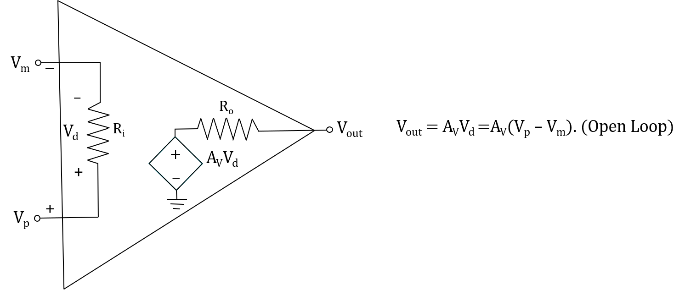
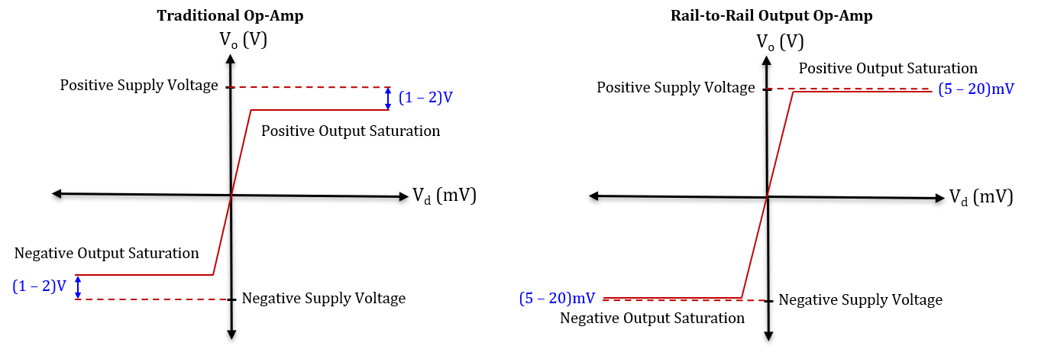
Operational Amplifiers – Op-Amps
Op-amp – Active circuit element designed to
perform the mathematical operations of addition,
subtraction, multiplication, division,
differentiation and integration.
The output of an op-amp behaves as a
voltage-controlled voltage-source.
Op-amps have very large open-loop voltage gain
(A_{V_OL} > 50,000 at low frequency), resulting in
output saturation for relatively small voltage
differences on the inputs.
Most op-amp applications incorporate
negative feedback, referred to as closed-loop
operation. This feedback usually results in a
closed-loop gain that is much smaller in
magnitude than the open-loop gain.
Op-amp output is governed by the voltage difference between the + and - inputs. Since V_{d} = 0 for common-mode input signals they are rejected.

Slide 4
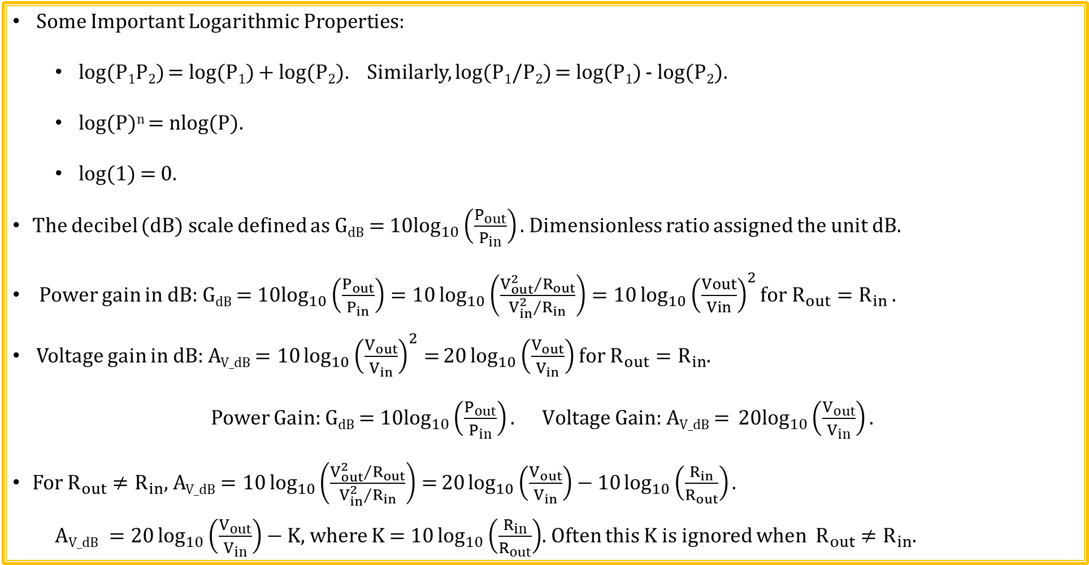
Logarithms and decibels (dB)
Some Important Logarithmic Properties:
log(P₁P₂) = log(P₁) + log(P₂). Similarly, log(P₁/P₂) = log(P₁) - log(P₂).
log(P)^{n} = nlog(P).
log(1) = 0.
The decibel (dB) scale defined as G_{dB} = ${10log}_{10}\left(\frac{P_{out}}{P_{in}}\right)\text{. }$Dimensionless ratio assigned the unit dB.
Power gain in dB: G_{dB} = ${10log}_{10}\left(\frac{P_{out}}{P_{in}}\right)=10\log_{10}\left(\frac{{V_{out}^{2}}/{R_{out}}}{{V_{in}^{2}}/{R_{in}}}\right)=10\log_{10}{{\left(\frac{Vout}{Vin}\right)}^{2}for R_{out}=R_{in}}.$
Voltage gain in dB: A_{V_dB} $=10\log_{10}{{\left(\frac{V_{out}}{V_{in}}\right)}^{2}=}20\log_{10}\left(\frac{V_{out}}{V_{in}}\right)$ for $R_{out}=R_{in}$.
Power Gain: G_{dB} = ${10log}_{10}\left(\frac{P_{out}}{P_{in}}\right). \text{Voltage} \text{Gain}\text{: }\text{AV}\text{_}\text{dB}\text{ = }{20log}_{10}\left(\frac{V_{out}}{V_{in}}\right).$
For $R_{out}≠R_{in}$, A_{V_dB} $=10\log_{10}\left(\frac{{V_{out}^{2}}/{R_{out}}}{{V_{in}^{2}}/{R_{in}}}\right)=20\log_{10}\left(\frac{V_{out}}{V_{in}}\right)−$ $10\log_{10}\left(\frac{R_{in}}{R_{out}}\right).$
$\text{A}\text{V}\text{_}\text{dB} =20\log_{10}\left(\frac{V_{out}}{V_{in}}\right)−$ K, where K = $10\log_{10}\left(\frac{R_{in}}{R_{out}}\right)$. Often this K is ignored when $R_{out}≠R_{in}$.

Slide 5
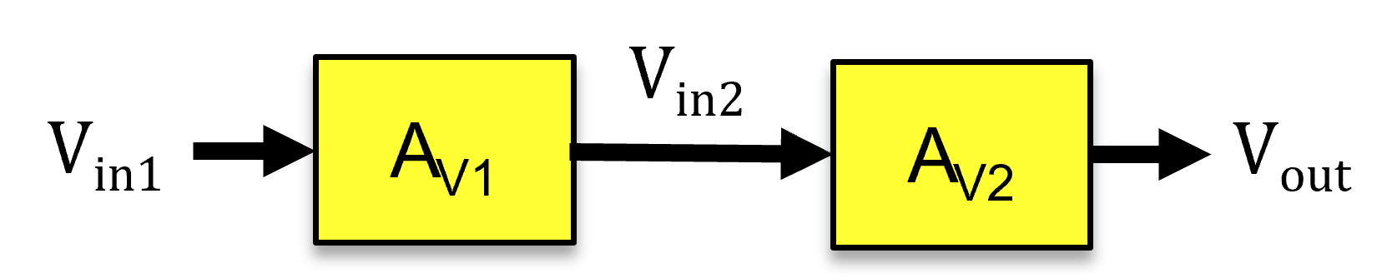
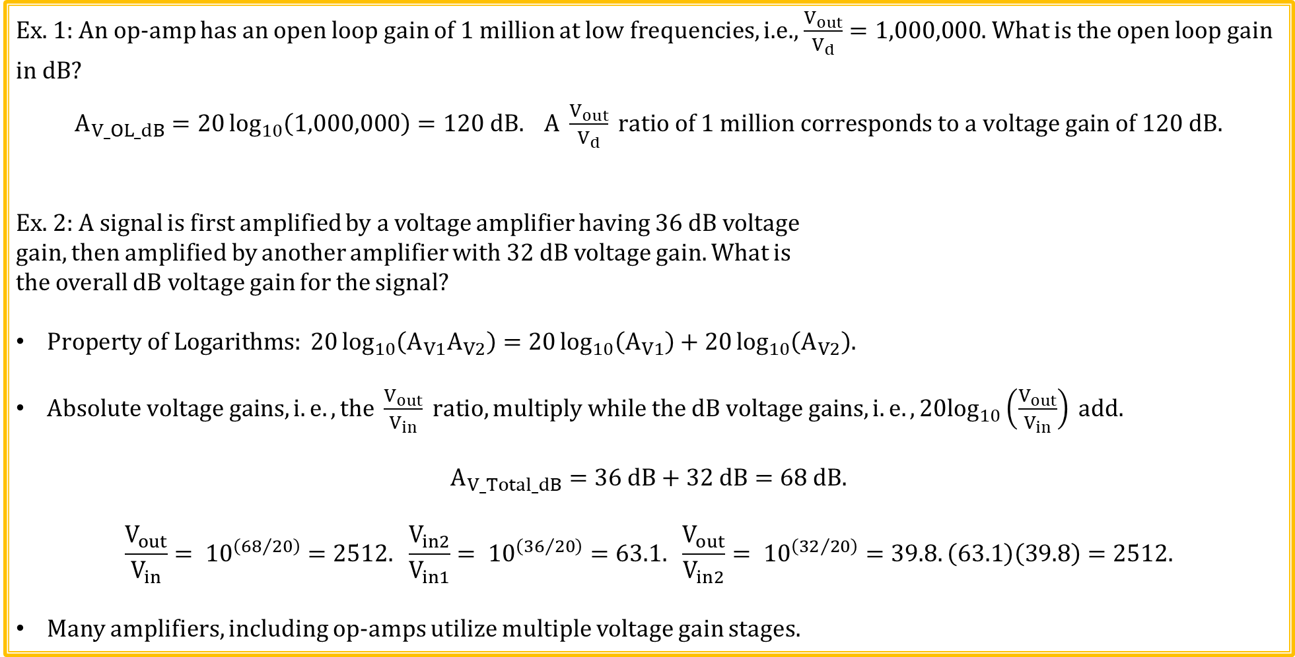
Voltage (dB) Example
Ex. 1: An op-amp has an open loop gain of 1 million at low frequencies, i.e., $\frac{V_{out}}{V_{d}}=1,000,000$. What is the open loop gain in dB?
$A_{V_OL_dB}=20\log_{10}\left(1,000,000\right)=120 dB. A \frac{V_{out}}{V_{d}} ratio of 1 million corresponds to a voltage gain of 120 dB.$
Ex. 2: A signal is first amplified by a voltage amplifier having 36 dB voltage
gain, then amplified by another amplifier with 32 dB voltage gain. What is
the overall dB voltage gain for the signal?
$Property of Logarithms: 20\log_{10}\left(A_{V1}A_{V2}\right)=20\log_{10}\left(A_{V1}\right)+20\log_{10}\left(A_{V2}\right).$
$Absolute voltage gains, i.e., the \frac{V_{out}}{V_{in}} ratio, multiply while the dB voltage gains, i.e. , 20\log_{10}\left(\frac{V_{out}}{V_{in}}\right) add.$
$$A_{V_Total_dB}=36 dB+32 dB=68 dB.$$
$$\frac{V_{out}}{V_{in}}= {10}^{\left({68}/{20}\right)}=2512. \frac{V_{in2}}{V_{in1}}= {10}^{\left({36}/{20}\right)}=63.1. \frac{V_{out}}{V_{in2}}= {10}^{\left({32}/{20}\right)}=39.8. \left(63.1\right)\left(39.8\right)=2512.$$
Many amplifiers, including op-amps utilize multiple voltage gain stages.

Slide 6
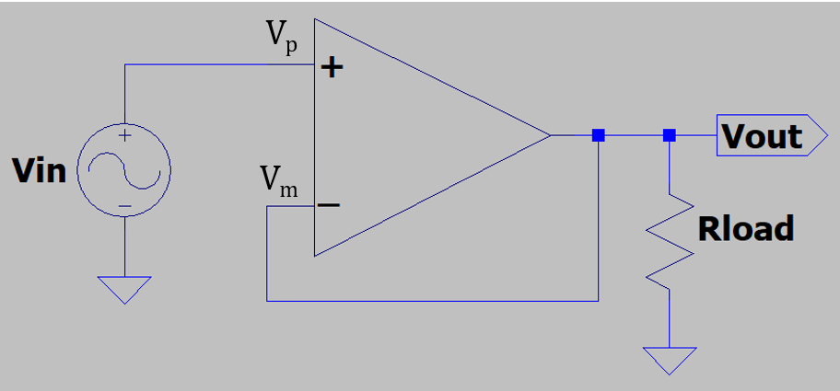
Ideal Voltage Follower
What is V_{out} and why in the adjacent circuit?
V_{p} = V_{in}. V_{out} = V_{m}.
Also, V_{p} = V_{m}. Therefore V_{out} = V_{in}.
Why does V_{p} = V_{m}?
Because of large open-loop voltage gain and negative feedback, V_{out} is always adjusts V_{m} towards V_{p}.
The only time that V_{out} is not adjusting V_{m} towards V_{p}, is when V_{m} = V_{p}, which implies V_{out} = V_{in}. Hence, V_{out} follows V_{in}.
If V_{out} became < V_{in}, then V_{p} > V_{m}, resulting in V_{out} increasing until V_{m} again equals V_{p}.
If V_{out} became > V_{in}, then V_{p} < V_{m}, resulting in V_{out} decreasing until V_{m} again equals V_{p}.
Since V_{out} = V_{in}, the resulting voltage gain with feedback, i.e., closed-loop gain = 1 because of negative feedback, whereas open-loop gain >> 1, where >> means much greater than.

Slide 7
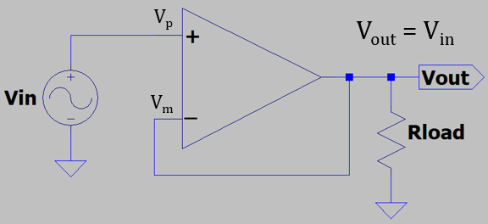
Feedback Control
Feedback control: Inverted Pendelum
Feedback control is used to keep the bottom (-) end of the pendulum in vertical alignment with the top (+) end, with the controller constantly minimizing any difference. As a result, the bottom (-) end follows the vertical position of the top (+) end of the inverted pendulum. The horizontal corrective response of the controller has to be larger than any misalignment to keep the pendelum inverted, making large horizontal gain and quick response time desirable. The larger the vertical mis-alignment, the larger the corrective response to minimize the misallignment.
Feedback control: Voltage Follower
Feedback control is used to keep the minus (-) input of the op-amp equal to the plus (+) input, with the op-amp output constantly minimizing any difference. As a result, the minus (-) input follows the voltage of the plus (+) input of the op-amp when the output is connected to the minus (-) input, referred to as negative feedback. The corrective response of the op-amp has to be larger than any |v_{p} - v_{m}|, for the output to follow the input, making large open-loop voltage gain and quick response time desirable. The larger the magnitude of v_{p} - v_{m},, i.e., |v_{p} - v_{m}|, the larger the corrective response to minimize |v_{p} - v_{m}|.

Slide 8
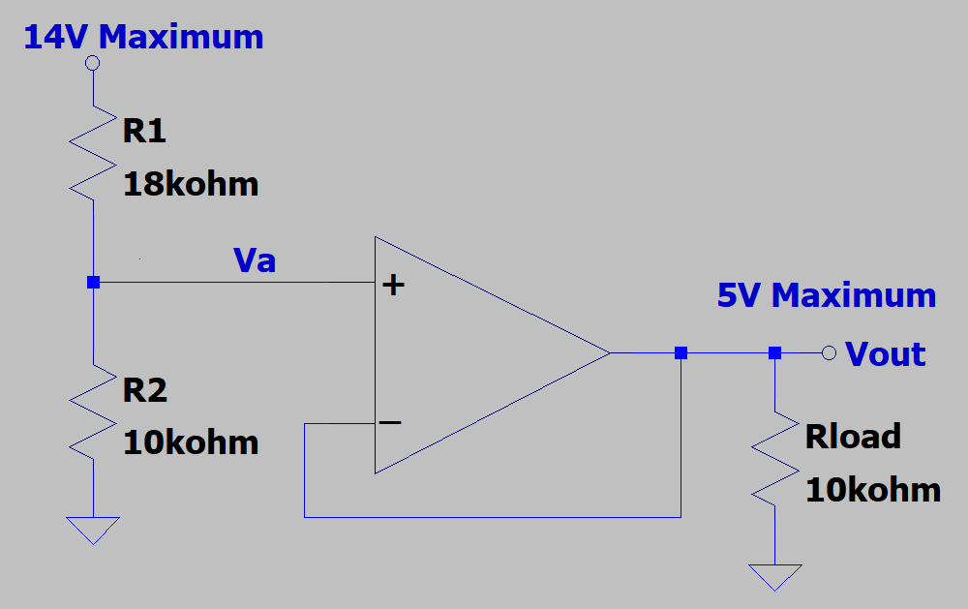
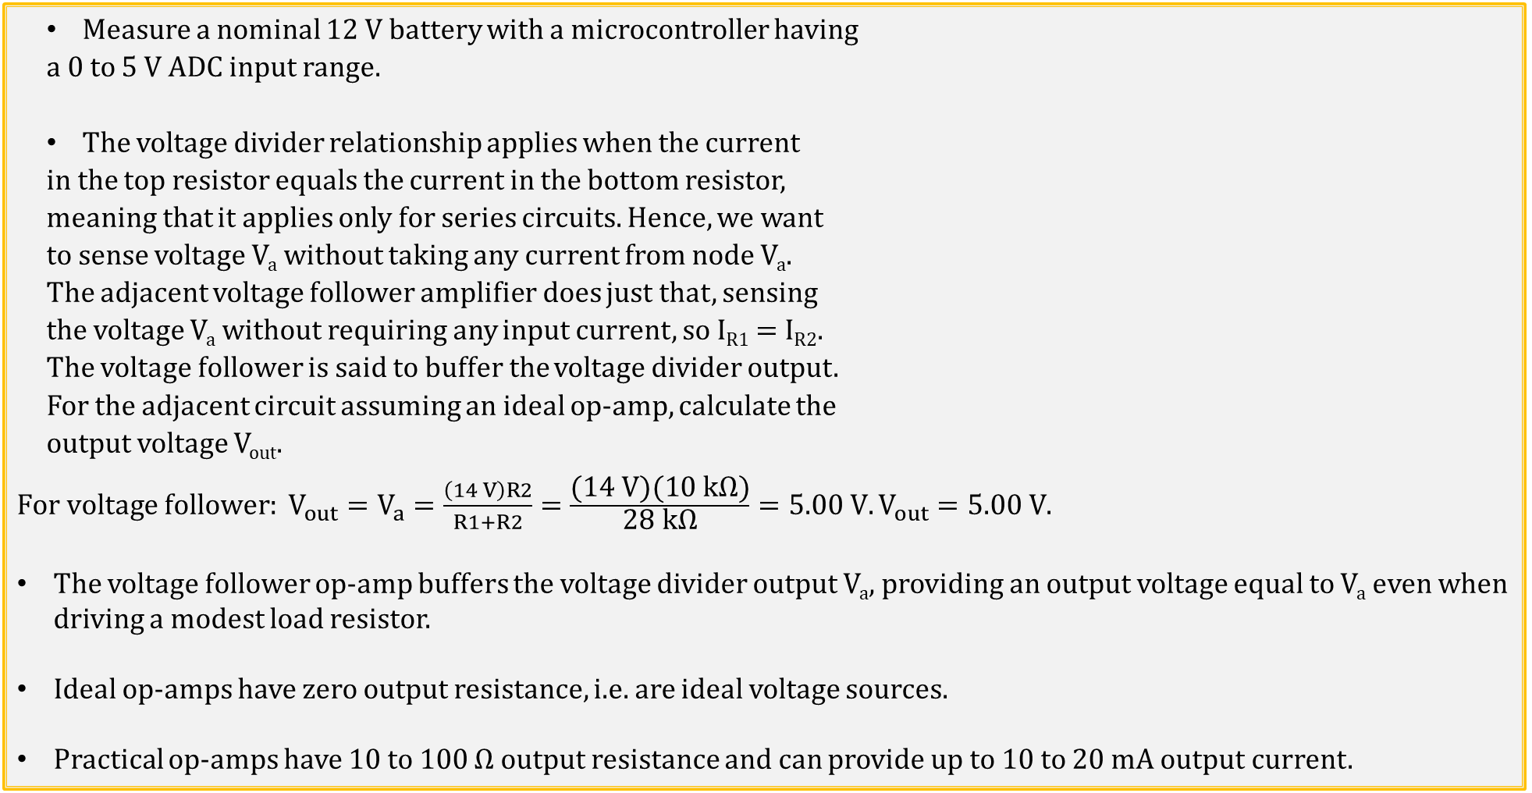
Voltage Divider and Follower Application
Measure a nominal 12 V battery with a microcontroller having
a 0 to 5 V ADC input range.
The voltage divider relationship applies when the current
in the top resistor equals the current in the bottom resistor,
meaning that it applies only for series circuits. Hence, we want
to sense voltage V_{a} without taking any current from node V_{a}.
The adjacent voltage follower amplifier does just that, sensing
the voltage V_{a} without requiring any input current, so I_{R1} = I_{R2}.
The voltage follower is said to buffer the voltage divider output.
For the adjacent circuit assuming an ideal op-amp, calculate the
output voltage V_{out}.
$For voltage follower: V_{out}=V_{a}=\frac{\left(14 V\right)R2}{R1+R2}=\frac{\text{(}\text{14} \text{V}\text{)(10 }\text{k}\text{Ω)}}{\text{28} \text{k}\text{Ω}}=5.00 V.V_{out}=5.00 V$.
The voltage follower op-amp buffers the voltage divider output V_{a}, providing an output voltage equal to V_{a} even when driving a modest load resistor.
Ideal op-amps have zero output resistance, i.e. are ideal voltage sources.
Practical op-amps have 10 to 100 Ω output resistance and can provide up to 10 to 20 mA output current.
Poll Questions

Slide 9
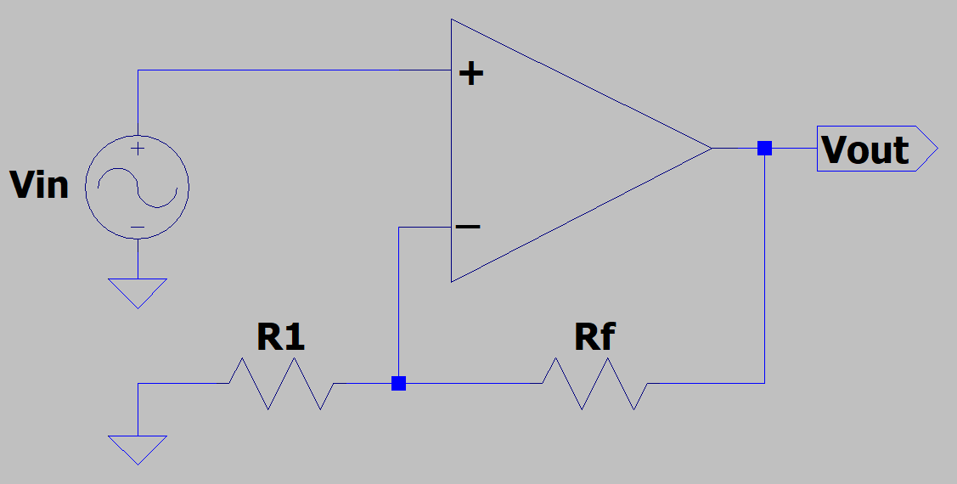
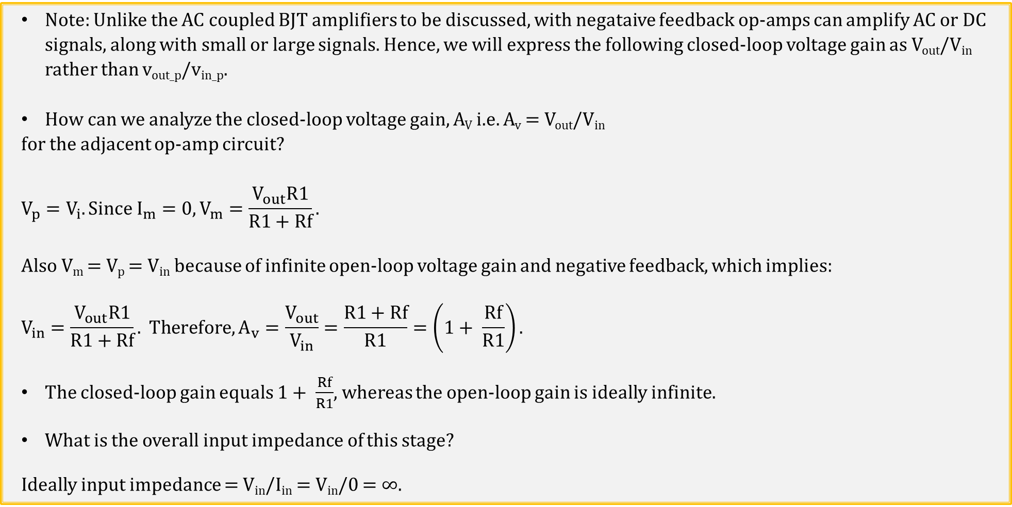
Non-Inverting Op-Amp Configuration
Note: Unlike the AC coupled BJT amplifiers to be discussed, with negataive feedback op-amps can amplify AC or DC signals, along with small or large signals. Hence, we will express the following closed-loop voltage gain as V_{out}/V_{in} rather than v_{out_p}/v_{in_p}.
How can we analyze the closed-loop voltage gain, A_{V} i.e. A_{v} = V_{out}/V_{in}
for the adjacent op-amp circuit?
$$V_{p}=V_{i}. Since I_{m}=0, V_{m}=\frac{V_{out}R1}{R1+Rf}.$$
Also V_{m} = V_{p} = V_{in} because of infinite open-loop voltage gain and negative feedback, which implies:
$$V_{in}=\frac{V_{out}R1}{R1+Rf}. Therefore, A_{v}=\frac{V_{out}}{V_{in}}=\frac{R1+Rf}{R1}=\left(1+ \frac{Rf}{R1}\right).$$
The closed-loop gain equals $1+ \frac{Rf}{R1}$, whereas the open-loop gain is ideally infinite.
What is the overall input impedance of this stage?
Ideally input impedance = V_{in}/I_{in} = V_{in}/0 = ∞.
Closed-loop gain for non-inverting configuration.

Slide 10
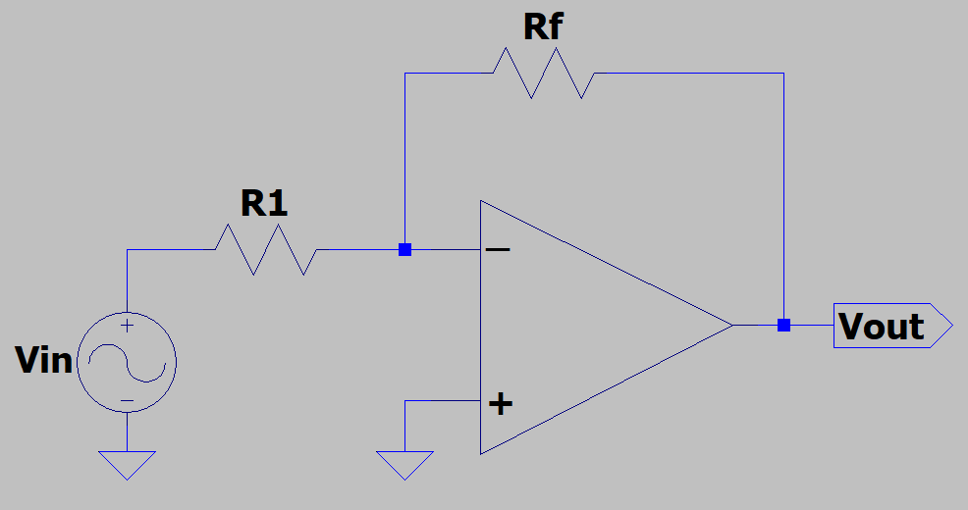
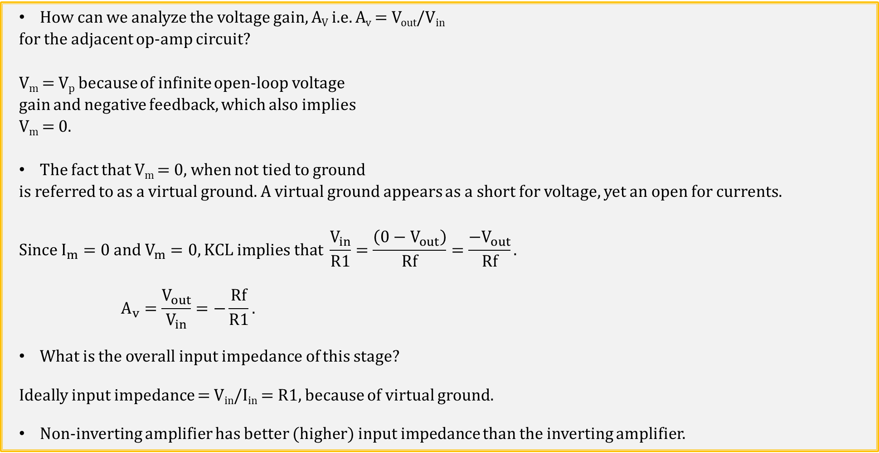
Inverting Op-Amp Configuration
How can we analyze the voltage gain, A_{V} i.e. A_{v} = V_{out}/V_{in}
for the adjacent op-amp circuit?
V_{m} = V_{p} because of infinite open-loop voltage
gain and negative feedback, which also implies
V_{m} = 0.
The fact that V_{m} = 0, when not tied to ground
is referred to as a virtual ground. A virtual ground appears as a short for voltage, yet an open for currents.
$$Since I_{m}=0 and V_{m}=0, KCL implies that \frac{V_{in}}{R1}=\frac{\left(0−V_{out}\right)}{Rf}=\frac{−V_{out}}{Rf}.$$
$$A_{v}=\frac{V_{out}}{V_{in}}=−\frac{Rf}{R1}.$$
What is the overall input impedance of this stage?
Ideally input impedance = V_{in}/I_{in} = R1, because of virtual ground.
Non-inverting amplifier has better (higher) input impedance than the inverting amplifier.
Closed-loop gain for inverting op-amp configuration.

Slide 11
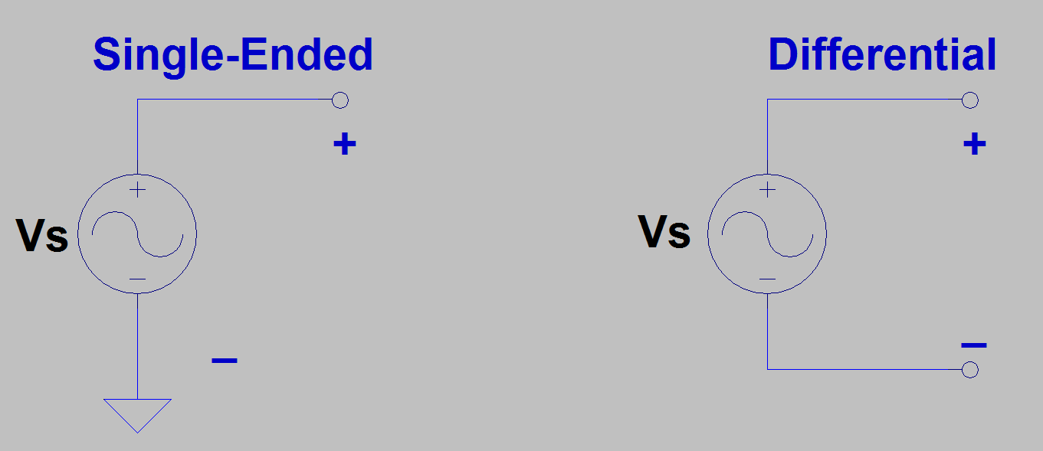
Single-Ended versus Double-Ended (Differential) Signals
Single-Ended (SE) Signal → Referenced to ground.
Differential (Diff) Signal → Referenced to opposite polarity terminal which is not necessarily ground.
Differential Signals are more immune to noise and ground bounce compared to single-ended, as noise and ground bounce are common-mode signals, i.e. common to both inputs, which are rejected by a differential input stage.
Examples of Single-Ended signals are ground referenced voltages, along with standard digital logic signals and RS-232.
Example of a Differential Signals are the output voltages of a Wheatstone bridge, along with digital RS-485, USB, and Ethernet signals.

Slide 12
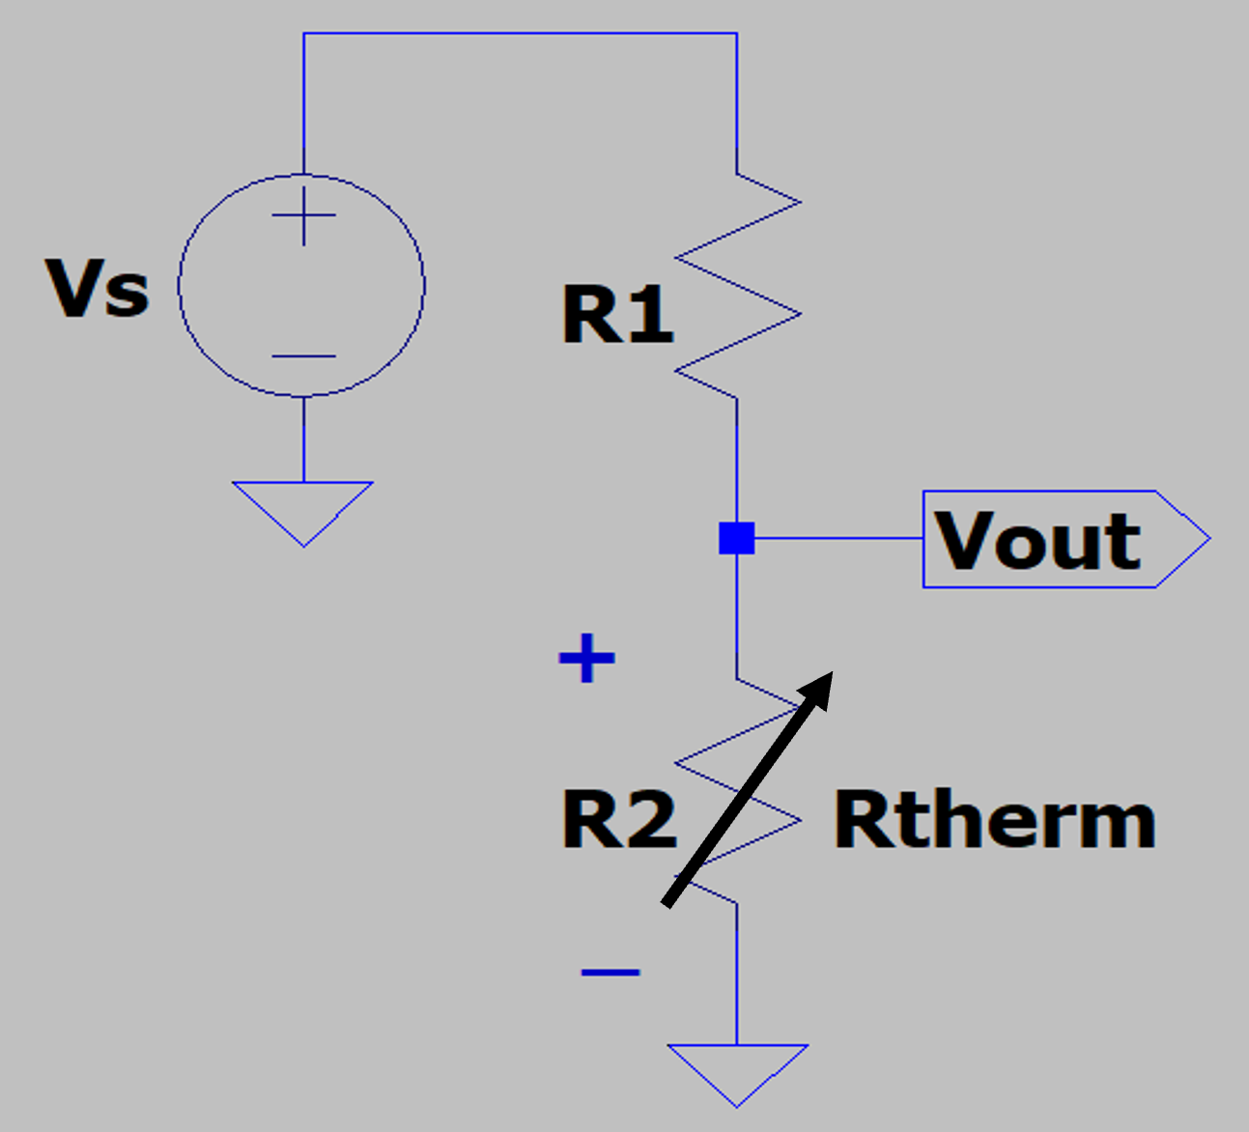
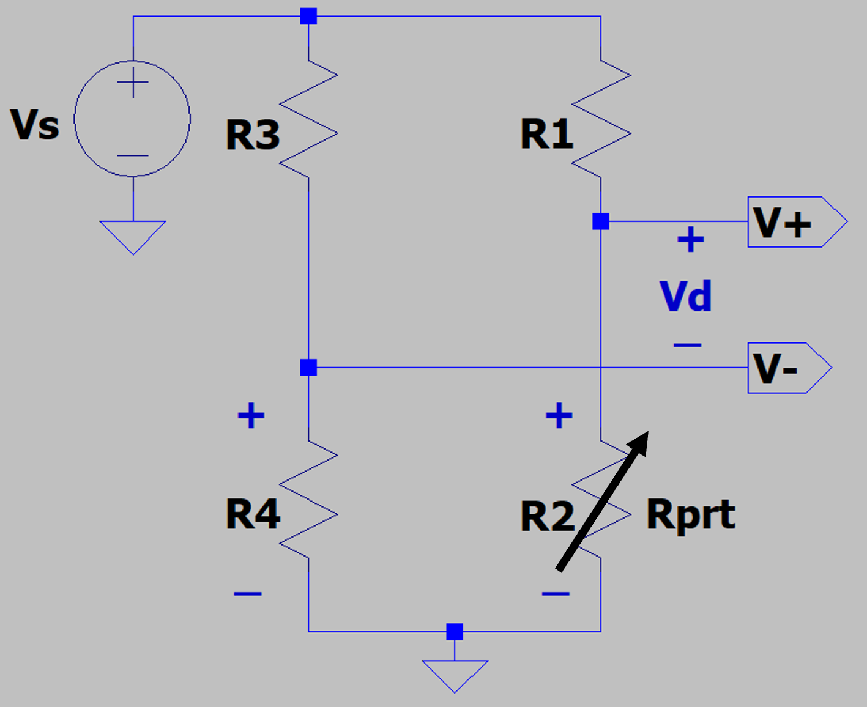
Single-Ended versus Double-Ended (Differential) Voltages
Single-Ended (SE) Signal → Referenced to ground.
Differential (Diff) Signal → Referenced to opposite polarity terminal which is not necessarily ground.
Differential Signals are more immune to noise and ground bounce compared to single-ended, as noise and ground bounce are common-mode signals, i.e. common to both inputs, which are rejected by a differential input stage.
Single-Ended Voltage Thermistor Measurement
Differential Voltage PRT Measurement

Slide 13
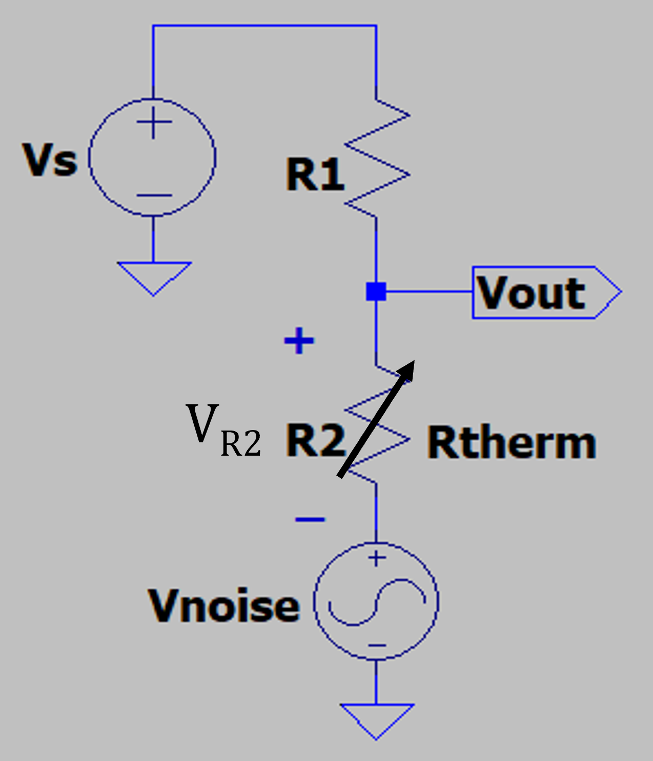
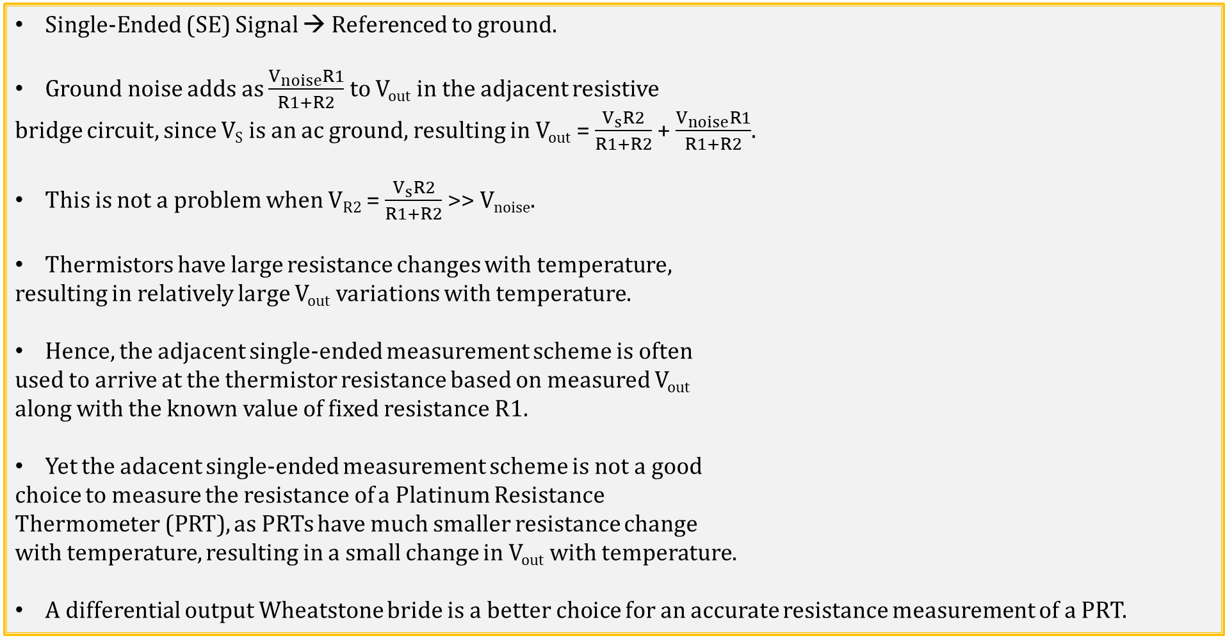
Single-Ended Voltage Measurement with Ground Noise
Single-Ended (SE) Signal → Referenced to ground.
Ground noise adds as $\frac{V_{noise}R1}{R1+R2}$ to V_{out} in the adjacent resistive
bridge circuit, since V_{S} is an ac ground, resulting in V_{out} = $\frac{V_{s}R2}{R1+R2}$ + $\frac{V_{noise}R1}{R1+R2}$.
This is not a problem when V_{R2} = $\frac{V_{s}R2}{R1+R2}$ >> V_{noise}.
Thermistors have large resistance changes with temperature,
resulting in relatively large V_{out} variations with temperature.
Hence, the adjacent single-ended measurement scheme is often
used to arrive at the thermistor resistance based on measured V_{out}
along with the known value of fixed resistance R1.
Yet the adacent single-ended measurement scheme is not a good
choice to measure the resistance of a Platinum Resistance
Thermometer (PRT), as PRTs have much smaller resistance change
with temperature, resulting in a small change in V_{out} with temperature.
A differential output Wheatstone bride is a better choice for an accurate resistance measurement of a PRT.
Single-Ended Voltage Thermistor Measurement

Slide 14
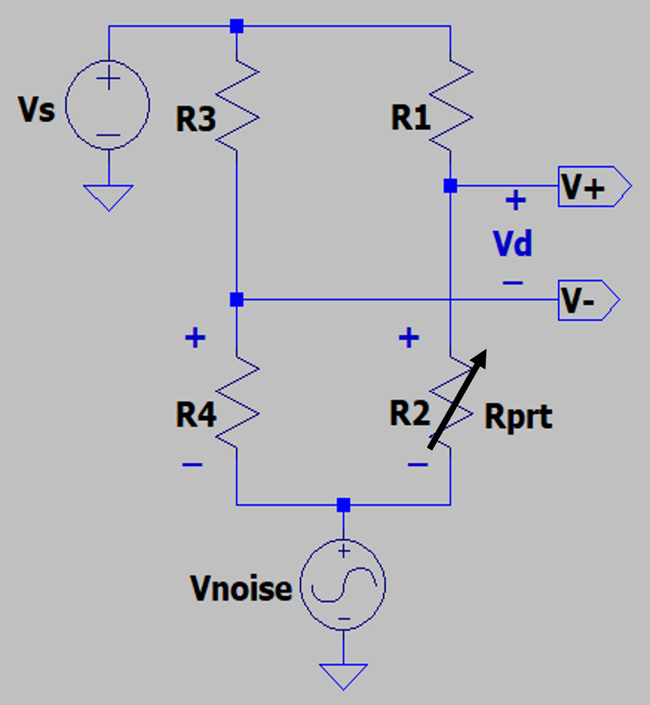
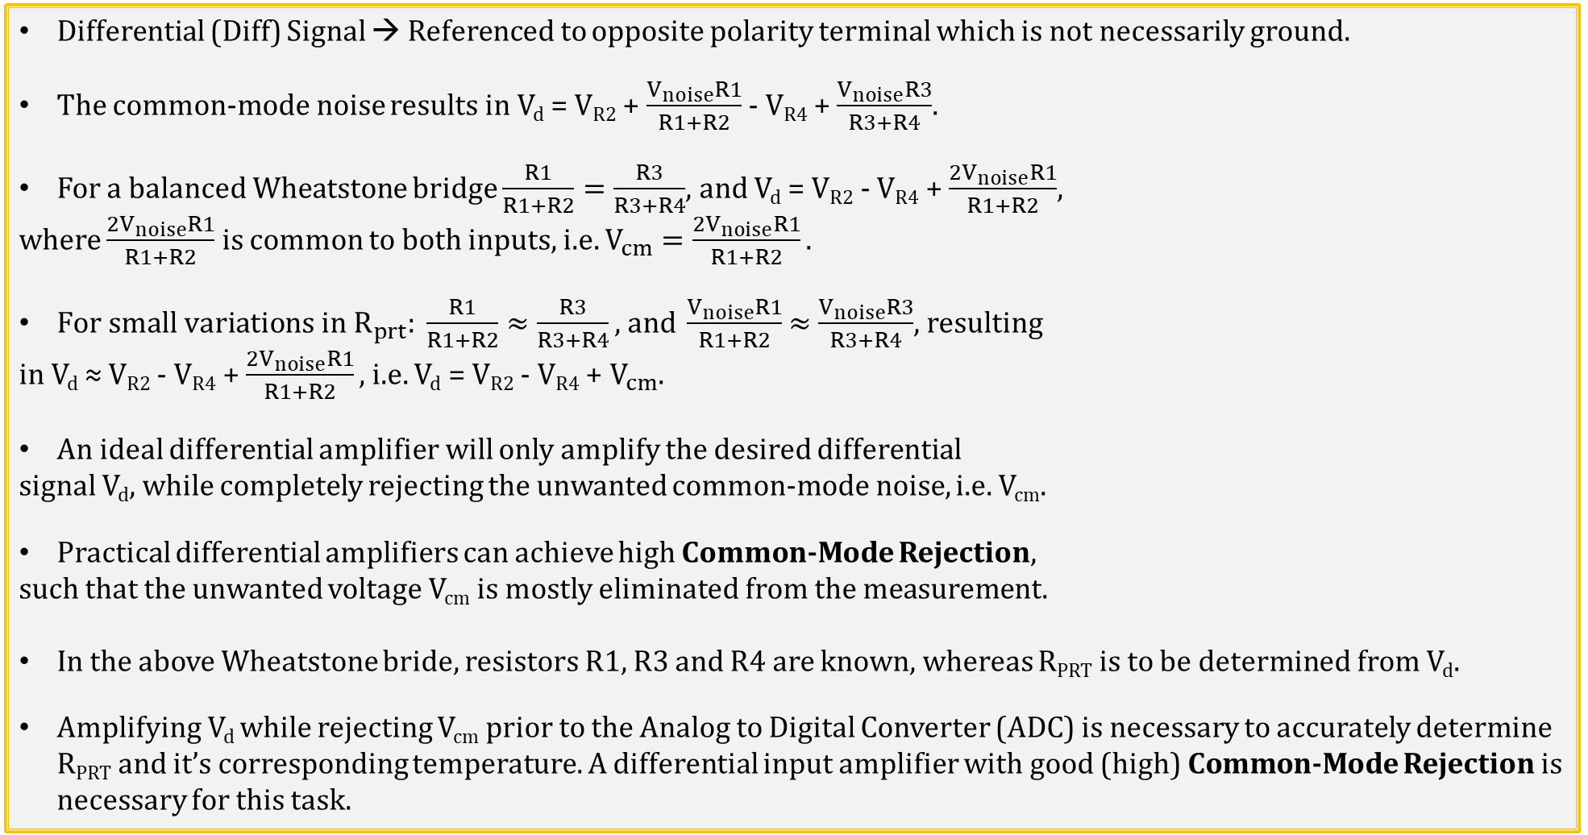
Differential Voltage Measurement with Ground Noise
Differential (Diff) Signal → Referenced to opposite polarity terminal which is not necessarily ground.
The common-mode noise results in V_{d} = V_{R2} + $\frac{V_{noise}R1}{R1+R2}$ - V_{R4} + $\frac{V_{noise}R3}{R3+R4}$.
For a balanced Wheatstone bridge $\frac{R1}{R1+R2}=\frac{R3}{R3+R4}$, and V_{d} = V_{R2} - V_{R4} + $\frac{2V_{noise}R1}{R1+R2}$,
where $\frac{2V_{noise}R1}{R1+R2}$ is common to both inputs, i.e. $V_{cm}=\frac{2V_{noise}R1}{R1+R2}.$
$For small variations in R_{prt}: \frac{R1}{R1+R2}≈\frac{R3}{R3+R4}\text{, }\text{and} \frac{V_{noise}R1}{R1+R2}$ $≈$ $\frac{V_{noise}R3}{R3+R4}$, resulting
in V_{d} ≈ V_{R2} - V_{R4} + $\frac{2V_{noise}R1}{R1+R2},$i.e. V_{d} = V_{R2} - V_{R4} + $V_{cm}$.
An ideal differential amplifier will only amplify the desired differential
signal V_{d}, while completely rejecting the unwanted common-mode noise, i.e. V_{cm}.
Practical differential amplifiers can achieve high Common-Mode Rejection,
such that the unwanted voltage V_{cm} is mostly eliminated from the measurement.
In the above Wheatstone bride, resistors R1, R3 and R4 are known, whereas R_{PRT} is to be determined from V_{d}.
Amplifying V_{d} while rejecting V_{cm} prior to the Analog to Digital Converter (ADC) is necessary to accurately determine R_{PRT} and it’s corresponding temperature. A differential input amplifier with good (high) Common-Mode Rejection is necessary for this task.
Differential Voltage PRT Measurement

Slide 15
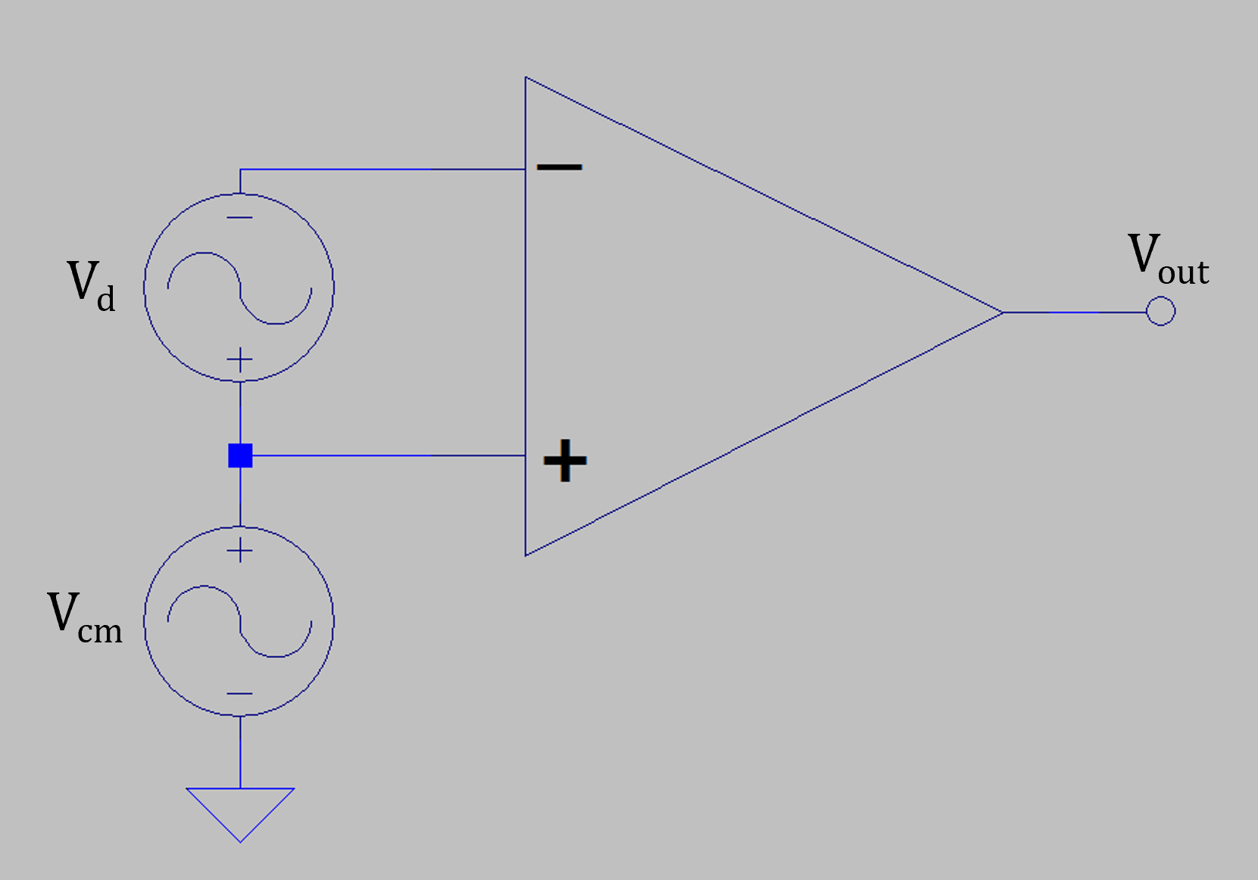
Common-Mode Rejection
Differential (Diff) Signal → Referenced to opposite polarity terminal which is not
necessarily ground.
The adjacent Wheatstone bridge circuit produces a differential voltage to be measured,
that is a function of R_{PRT}, the resistance of the PRT (Platinum Resistance Thermometer).
Want a differential amplifier that will amplify the relatively small differential
signal V_{d}, while rejecting the unwanted common-mode noise V_{cm} of the adjacent
Wheatstone bridge circuit.
A differential input amplifier with good (high) Common-Mode Rejection is
necessary for this task.
A standard op-amp incorporating negative feedback is not sufficient as a differential
amplifier for a Wheatstone bridge, as there is only 1 remaining input.
Special differential amplifier ICs, referred to as instrumentation amplifiers (IAs), provide
the desired differential mode gain, along with good (large) common-mode rejection.

Slide 16
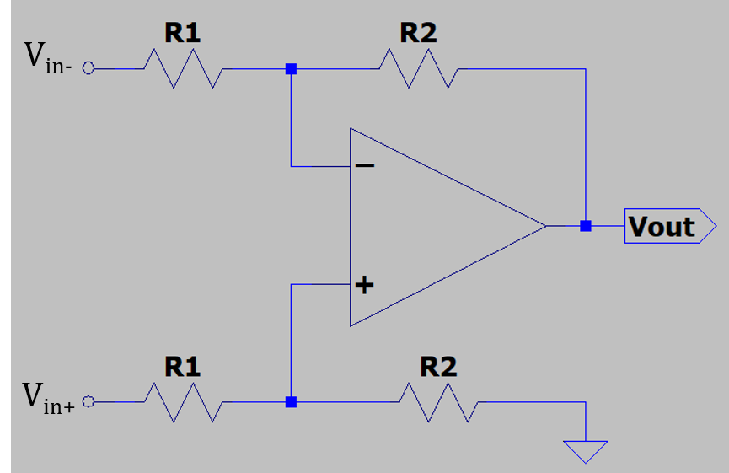
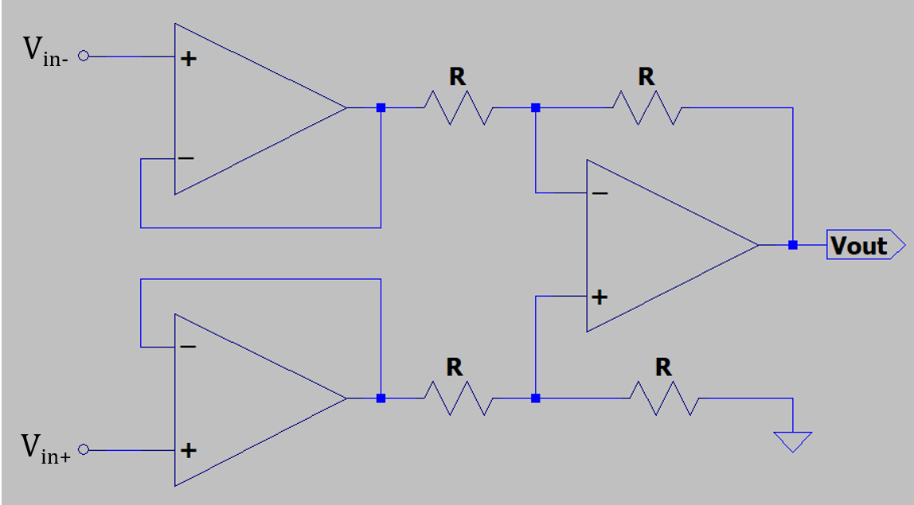
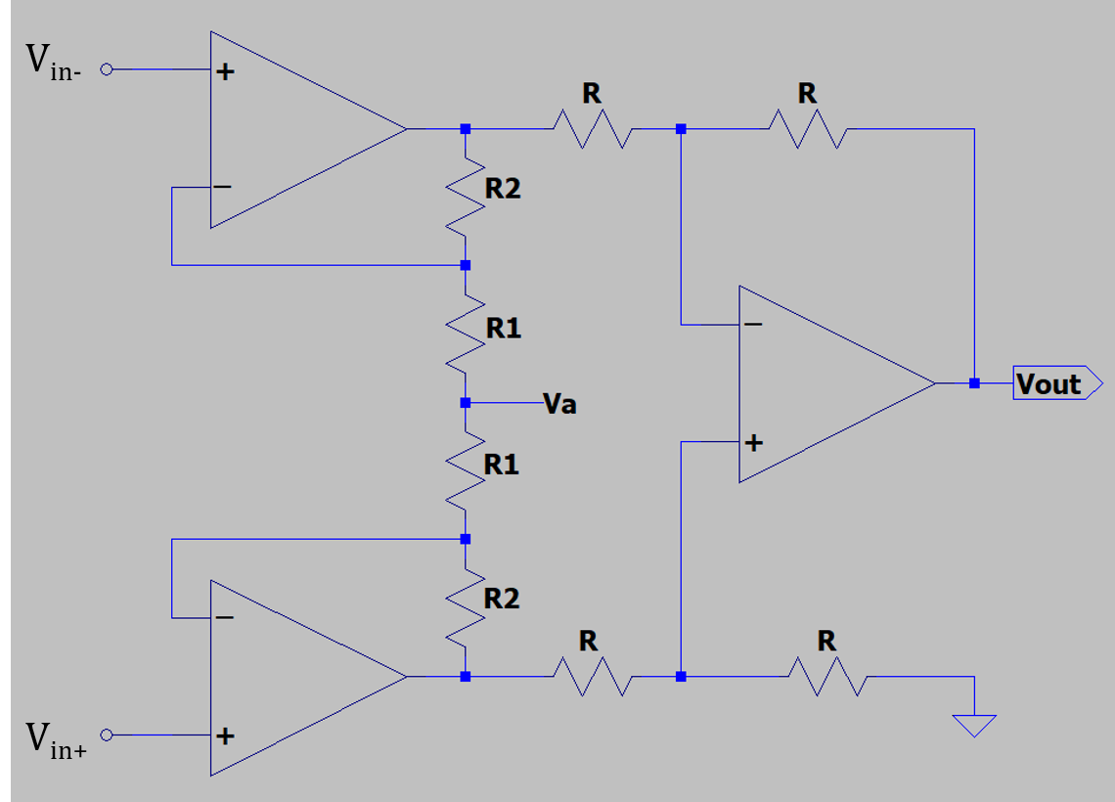
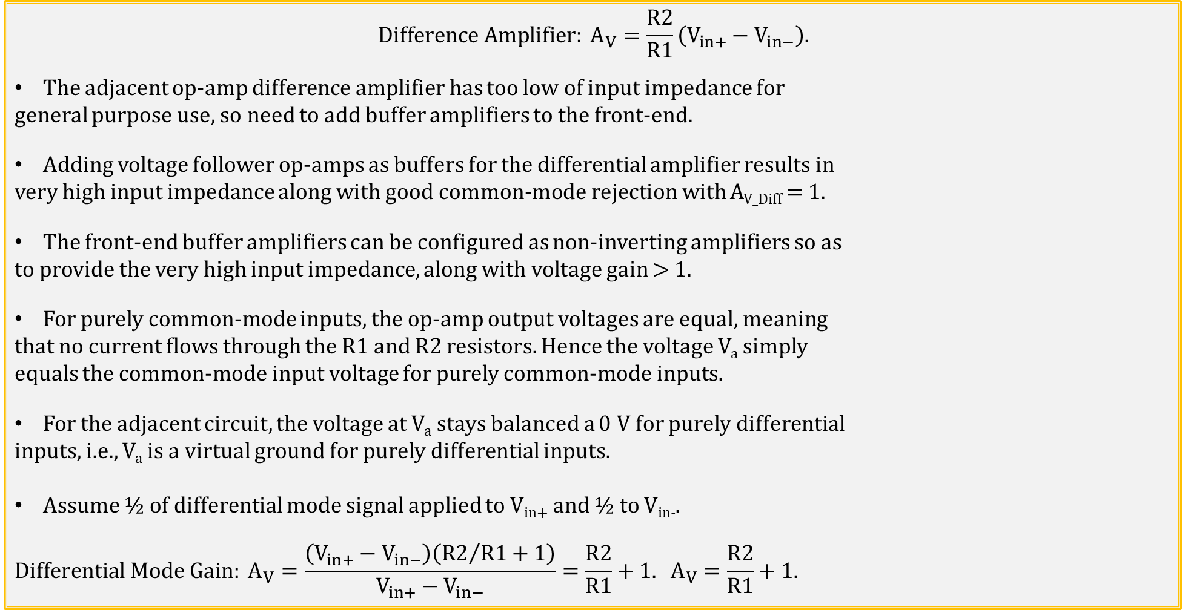
Practical Differential Amplifier Circuit (Continued)
$$Difference Amplifier: A_{V}=\frac{R2}{R1}\left(V_{in+}−V_{in−}\right).$$
The adjacent op-amp difference amplifier has too low of input impedance for
general purpose use, so need to add buffer amplifiers to the front-end.
Adding voltage follower op-amps as buffers for the differential amplifier results in
very high input impedance along with good common-mode rejection with A_{V_Diff} = 1.
The front-end buffer amplifiers can be configured as non-inverting amplifiers so as
to provide the very high input impedance, along with voltage gain > 1.
For purely common-mode inputs, the op-amp output voltages are equal, meaning
that no current flows through the R1 and R2 resistors. Hence the voltage V_{a} simply
equals the common-mode input voltage for purely common-mode inputs.
For the adjacent circuit, the voltage at V_{a} stays balanced a 0 V for purely differential
inputs, i.e., V_{a} is a virtual ground for purely differential inputs.
Assume ½ of differential mode signal applied to V_{in+} and ½ to V_{in-}.
$$Differential Mode Gain: A_{V}=\frac{\left(V_{in+}−V_{in−}\right)\left({R2}/{R1+1}\right)}{V_{in+}−V_{in−}}=\frac{R2}{R1}+1. A_{V}=\frac{R2}{R1}+1\text{.}$$

Slide 17
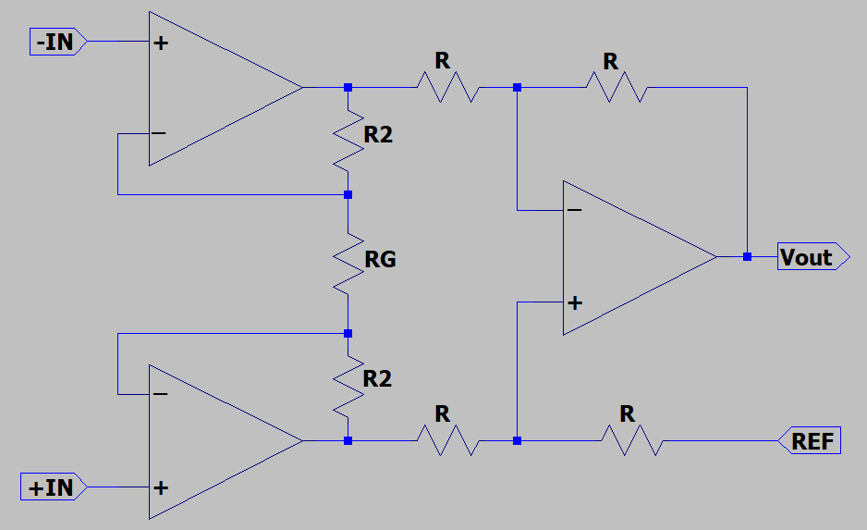
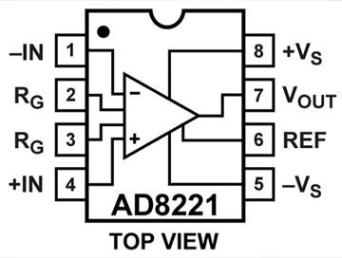
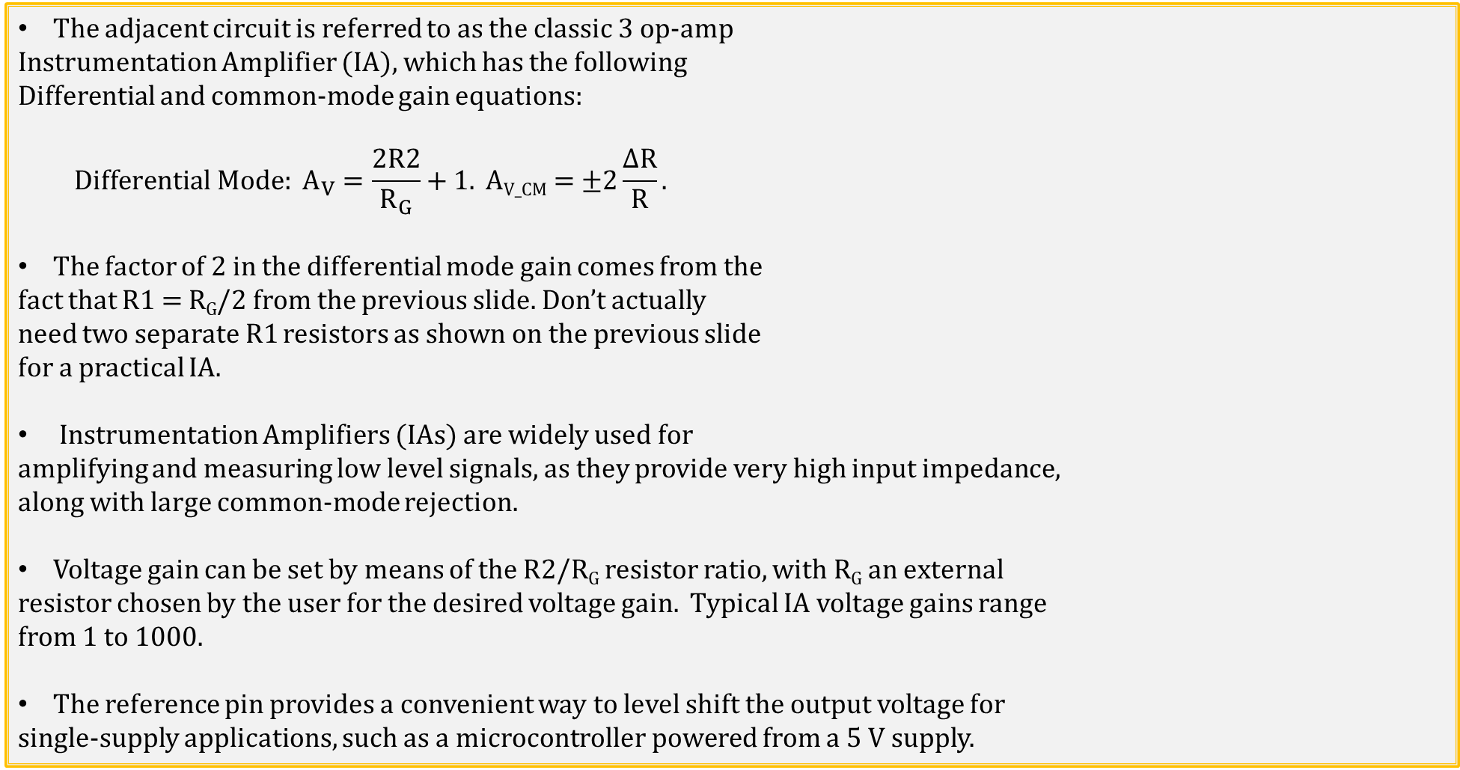
Classic 3-Op-Amp Instrumentation Amplifier (IA)
The adjacent circuit is referred to as the classic 3 op-amp
Instrumentation Amplifier (IA), which has the following
Differential and common-mode gain equations:
$$Differential Mode: A_{V}=\frac{2R2}{R_{G}}+1. \text{A}\text{V}\text{_}\text{CM}\text{ = ±2}\frac{\text{∆}\text{R}}{R}.$$
The factor of 2 in the differential mode gain comes from the
fact that R1 = R_{G}/2 from the previous slide. Don’t actually
need two separate R1 resistors as shown on the previous slide
for a practical IA.
Instrumentation Amplifiers (IAs) are widely used for
amplifying and measuring low level signals, as they provide very high input impedance,
along with large common-mode rejection.
Voltage gain can be set by means of the R2/R_{G} resistor ratio, with R_{G} an external
resistor chosen by the user for the desired voltage gain. Typical IA voltage gains range
from 1 to 1000.
The reference pin provides a convenient way to level shift the output voltage for
single-supply applications, such as a microcontroller powered from a 5 V supply.

Slide 18
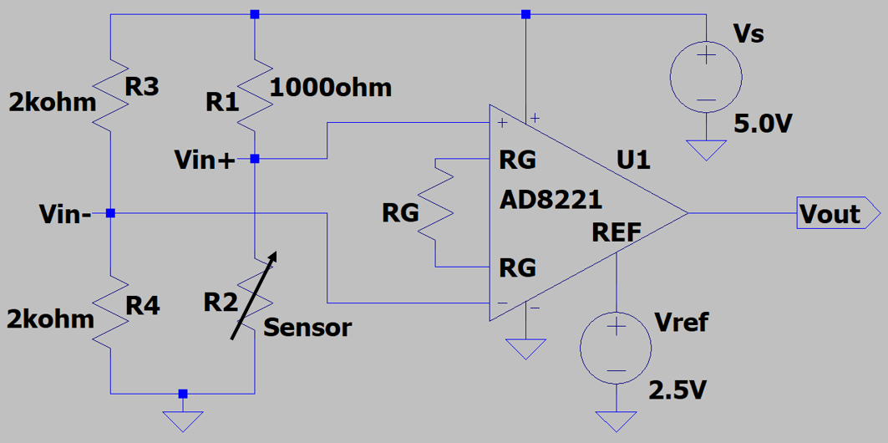
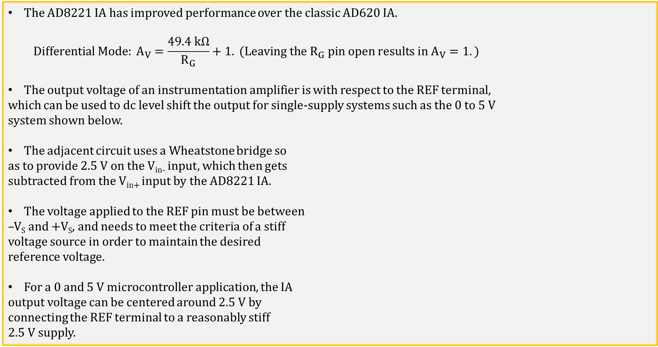
AD8221 IC Instrumentation Amplifier (IA)
The AD8221 IA has improved performance over the classic AD620 IA.
$$Differential Mode: A_{V}=\frac{49.4 kΩ}{R_{G}}+1.\text{ (}\text{Leaving} \text{the} R_{G} pin open results in A_{V}=1.)$$
The output voltage of an instrumentation amplifier is with respect to the REF terminal,
which can be used to dc level shift the output for single-supply systems such as the 0 to 5 V
system shown below.
The adjacent circuit uses a Wheatstone bridge so
as to provide 2.5 V on the V_{in-} input, which then gets
subtracted from the V_{in+} input by the AD8221 IA.
The voltage applied to the REF pin must be between
–V_{S} and +V_{S}, and needs to meet the criteria of a stiff
voltage source in order to maintain the desired
reference voltage.
For a 0 and 5 V microcontroller application, the IA
output voltage can be centered around 2.5 V by
connecting the REF terminal to a reasonably stiff
2.5 V supply.

Slide 19
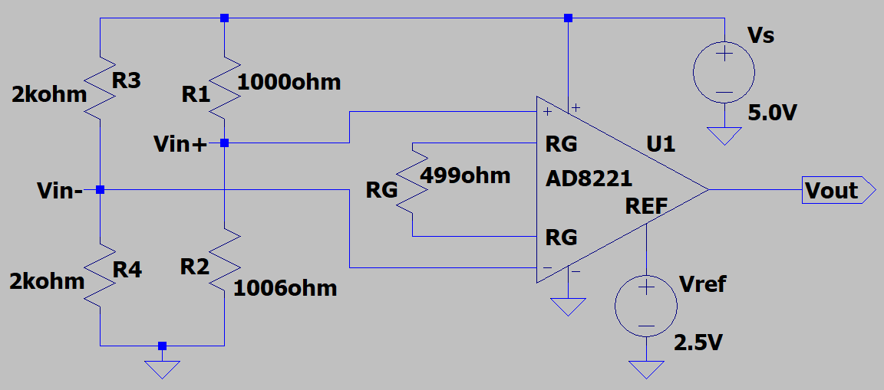
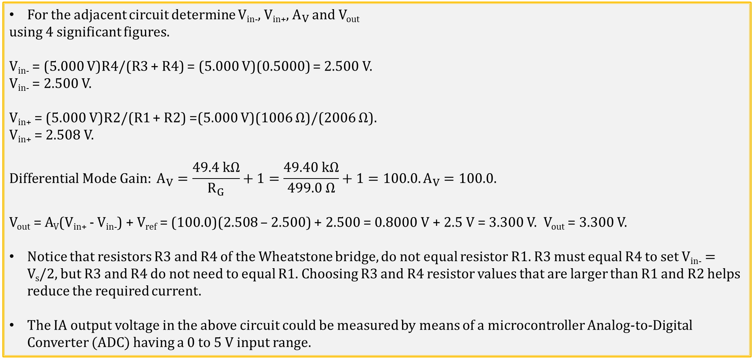
AD8221 IC Instrumentation Amplifier Example 1
For the adjacent circuit determine V_{in-}, V_{in+}, $A_{V}$ and V_{out}
using 4 significant figures.
V_{in-} = (5.000 V)R4/(R3 + R4) = (5.000 V)(0.5000) = 2.500 V.
V_{in-} = 2.500 V.
V_{in+} = (5.000 V)R2/(R1 + R2) =(5.000 V)(1006 Ω)/(2006 Ω).
V_{in+} = 2.508 V.
$$Differential Mode Gain: A_{V}=\frac{49.4 kΩ}{R_{G}}+1=\frac{49.40 kΩ}{499.0 Ω}+1=100.0. A_{V}=100.0.$$
V_{out} = A_{V}(V_{in+} - V_{in-}) + V_{ref} = (100.0)(2.508 – 2.500) + 2.500 = 0.8000 V + 2.5 V = 3.300 V. V_{out} = 3.300 V.
Notice that resistors R3 and R4 of the Wheatstone bridge, do not equal resistor R1. R3 must equal R4 to set V_{in-} = V_{s}/2, but R3 and R4 do not need to equal R1. Choosing R3 and R4 resistor values that are larger than R1 and R2 helps reduce the required current.
The IA output voltage in the above circuit could be measured by means of a microcontroller Analog-to-Digital Converter (ADC) having a 0 to 5 V input range.

Slide 20
Instrumentation Amplifiers (IAs) versus Op-Amps
Why use an IA versus a regular op-amp, as op-amps offer differential inputs?
While op-amps offer differential inputs, the resulting voltage gain, i.e., open-loop voltage gain, is very large and not well controlled. Hence, op-amps cannot provide a well controlled voltage gain for differential inputs.
To get a well controlled, i.e., closed-loop, gain from an op-amp, negative feedback must be employed which then uses the minus input, leaving only a single input. Hence, op-amps can only amplify single-ended signals in closed-loop configurations.
Whereas Instrumentation Amplifiers (IAs) provide well-controlled gain for differential input signals.
Wheatstone bridges are commonly used to provide differential signals from sensors that have small ∆R/R changes to the quantity being sensed, such as PRT’s and Strain Gauges.
IAs are commonly used to buffer and amplify the low-level differential voltages from Wheatstone bridges associated with PRT’s and Strain Gauges.
IAs can also be used for single-ended inputs, by simply tying the minus input to the signal reference (ground).

Slide 21
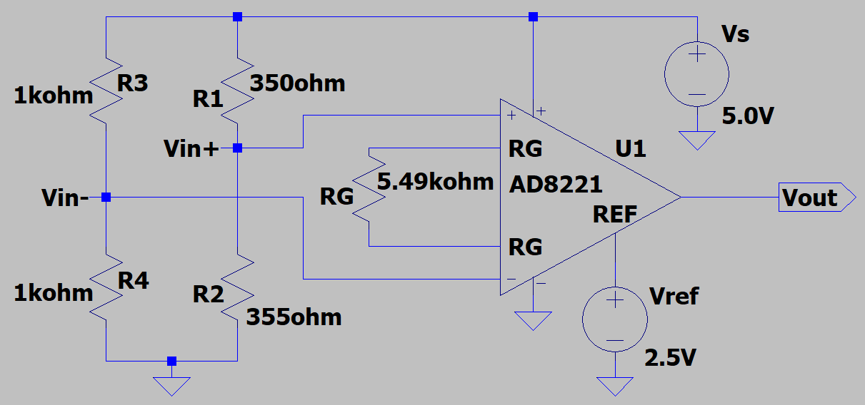
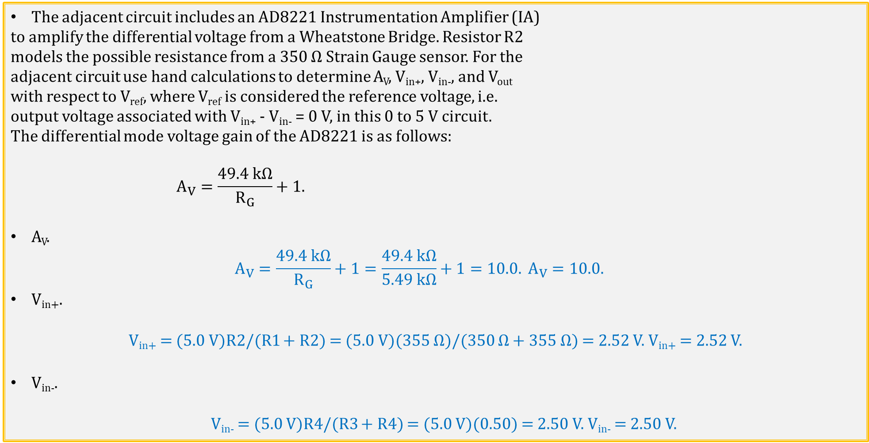
AD8221 IC Instrumentation Amplifier Example 2
The adjacent circuit includes an AD8221 Instrumentation Amplifier (IA)
to amplify the differential voltage from a Wheatstone Bridge. Resistor R2
models the possible resistance from a 350 Ω Strain Gauge sensor. For the
adjacent circuit use hand calculations to determine A_{V}, V_{in+}, V_{in-}, and V_{out}
with respect to V_{ref}, where V_{ref} is considered the reference voltage, i.e.
output voltage associated with V_{in+} - V_{in-} = 0 V, in this 0 to 5 V circuit.
The differential mode voltage gain of the AD8221 is as follows:
$$A_{V}=\frac{49.4 kΩ}{R_{G}}+1.$$
A_{V}.
$$A_{V}=\frac{49.4 kΩ}{R_{G}}+1=\frac{49.4 kΩ}{5.49 kΩ}+1=10.0. A_{V}=10.0.$$
V_{in+}.
V_{in+} = (5.0 V)R2/(R1 + R2) = (5.0 V)(355 Ω)/(350 Ω + 355 Ω) = 2.52 V. V_{in+} = 2.52 V.
V_{in-}.
V_{in-} = (5.0 V)R4/(R3 + R4) = (5.0 V)(0.50) = 2.50 V. V_{in-} = 2.50 V.

Slide 22
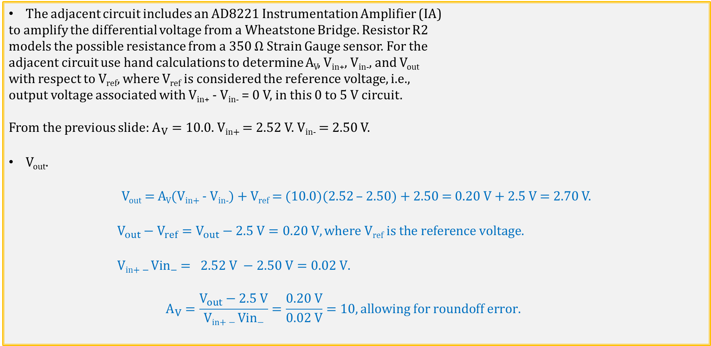
AD8221 IC IA Example 2 (Continued)
The adjacent circuit includes an AD8221 Instrumentation Amplifier (IA)
to amplify the differential voltage from a Wheatstone Bridge. Resistor R2
models the possible resistance from a 350 Ω Strain Gauge sensor. For the
adjacent circuit use hand calculations to determine A_{V}, V_{in+}, V_{in-}, and V_{out}
with respect to V_{ref}, where V_{ref} is considered the reference voltage, i.e.,
output voltage associated with V_{in+} - V_{in-} = 0 V, in this 0 to 5 V circuit.
From the previous slide: $A_{V}=10.0.$ V_{in+} = 2.52 V. V_{in-} = 2.50 V.
V_{out}.
V_{out} = A_{V}(V_{in+} - V_{in-}) + V_{ref} = (10.0)(2.52 – 2.50) + 2.50 = 0.20 V + 2.5 V = 2.70 V.
$$V_{out}−V_{ref}=V_{out}−2.5 V=0.20 V, where \text{V}\text{ref} \text{is} \text{the} \text{reference} \text{voltage}\text{.}$$
$$\text{V}\text{in}\text{+ − }\text{Vin}\text{−}= 2.52 V −2.50 V=0.02 V.$$
$$A_{V}=\frac{V_{out}−2.5 V}{\text{V}\text{in}\text{+ − }\text{Vin}\text{−}}=\frac{0.20 V}{0.02 V}=10, allowing for roundoff error.$$

Slide 23
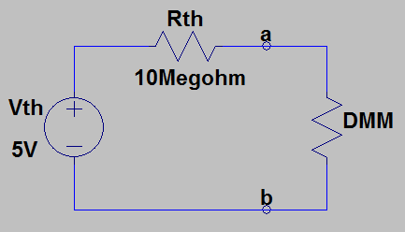
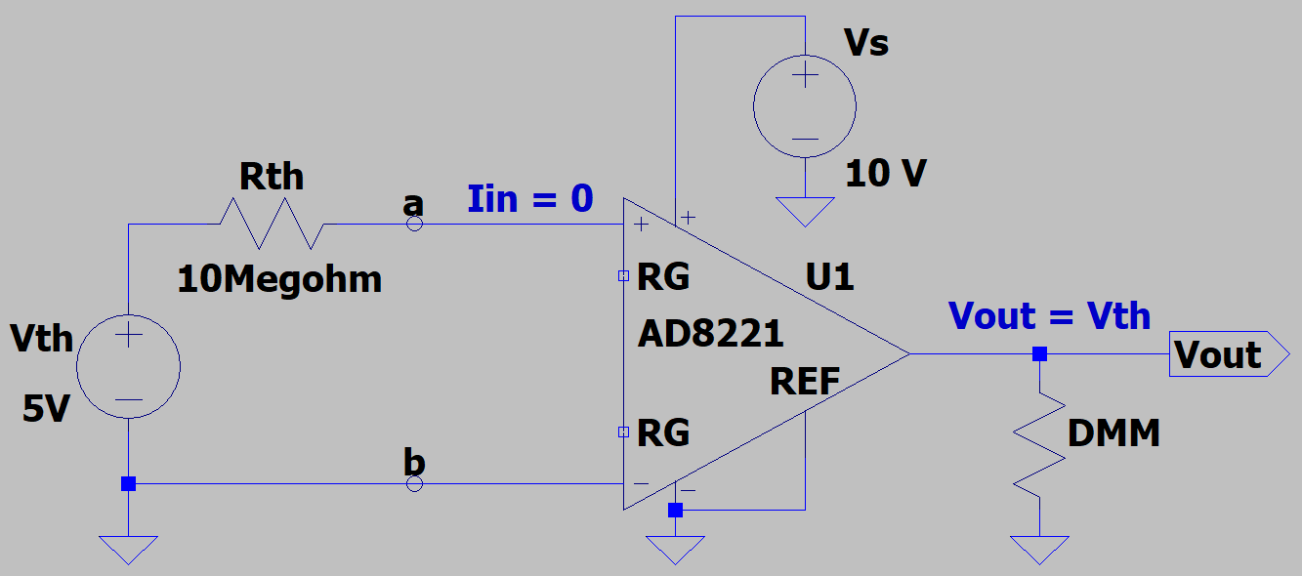
Instrumentation Amplifier as a Buffer
DMM Measurement Details Lab Circuit.
10 MΩ output (Thevenin) resistance equals
10 MΩ input resistance of a standard DMM.
Result is a voltage divider with a standard DMM
measuring approximately 2.5 V instead of 5.0 V. (-50%).
Need a buffer stage, i.e. very high input impedance, followed by relatively low output impedance to fix this measurement problem.
Instrumentation Amplifier does the job well.
For the buffer output, the 10 MΩ input resistance of a
standard DMM is no problem because of the relatively low
output-impedance of the IA.
Ideally hand-held DMMs report a measured voltage
equal to V_{th} with buffer circuit.

Slide 24
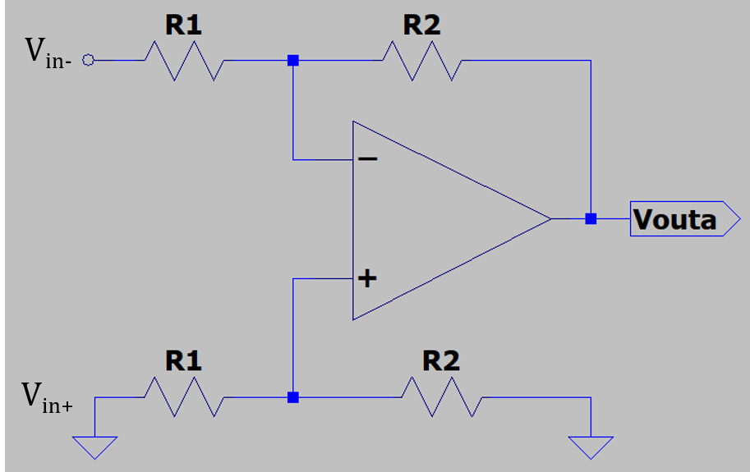
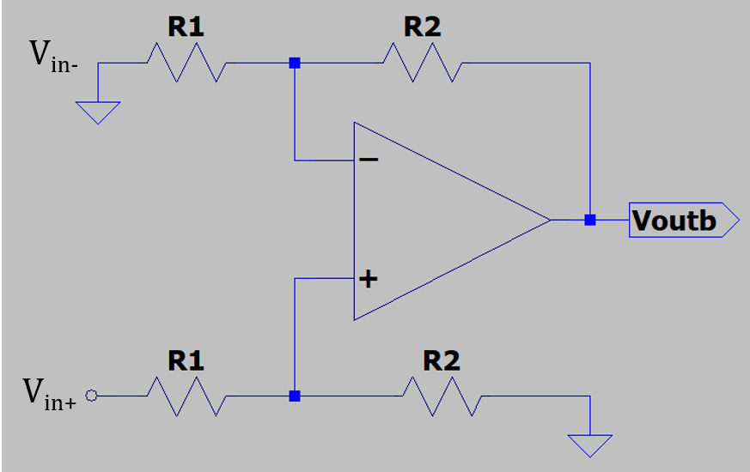
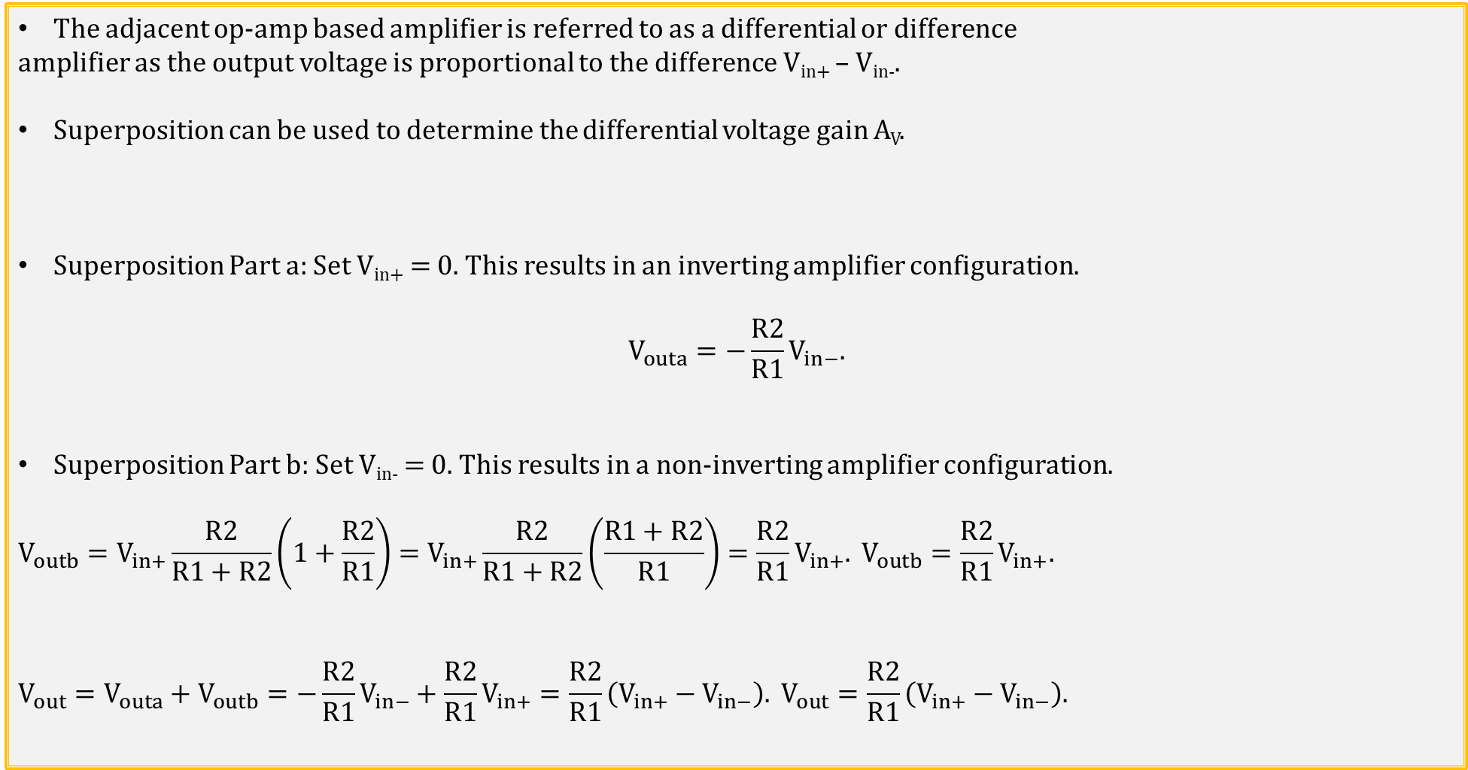
Practical Differential Amplifier Circuit
The adjacent op-amp based amplifier is referred to as a differential or difference
amplifier as the output voltage is proportional to the difference V_{in+} – V_{in-}.
Superposition can be used to determine the differential voltage gain A_{V}.
Superposition Part a: Set V_{in+} = 0. This results in an inverting amplifier configuration.
$$V_{outa}=−\frac{R2}{R1}V_{in−}.$$
Superposition Part b: Set V_{in-} = 0. This results in a non-inverting amplifier configuration.
$$V_{outb}=V_{in+}\frac{R2}{R1+R2}\left(1+\frac{R2}{R1}\right)=V_{in+}\frac{R2}{R1+R2}\left(\frac{R1+R2}{R1}\right)=\frac{R2}{R1}V_{in+}. V_{outb}=\frac{R2}{R1}V_{in+}.$$
$$V_{out}=V_{outa}+V_{outb}=−\frac{R2}{R1}V_{in−}+\frac{R2}{R1}V_{in+}=\frac{R2}{R1}\left(V_{in+}−V_{in−}\right). V_{out}=\frac{R2}{R1}\left(V_{in+}−V_{in−}\right).$$

Slide 25
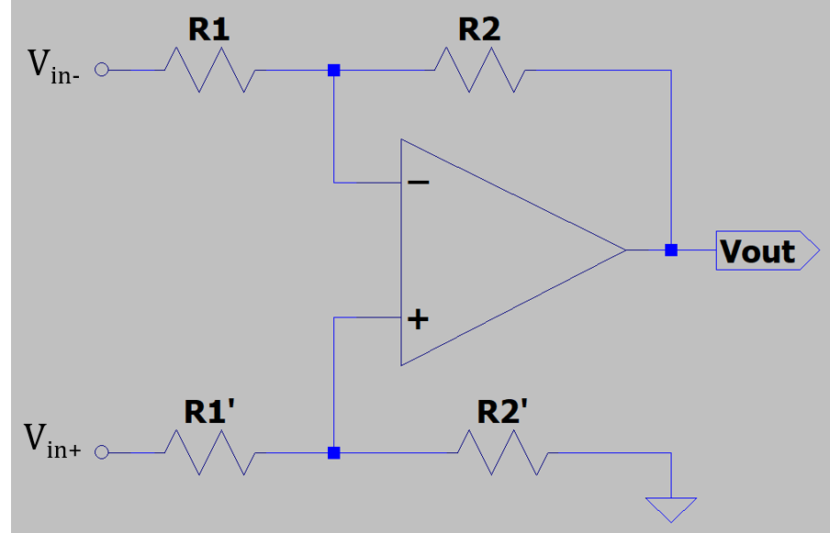
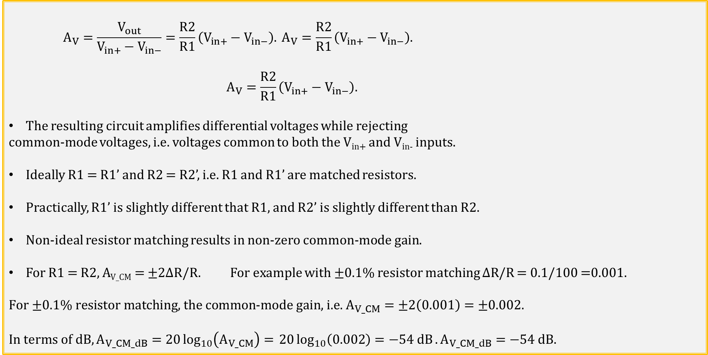
Practical Differential Amplifier Circuit (Continued)
$$A_{V}=\frac{V_{out}}{V_{in+}−V_{in−}}=\frac{R2}{R1}\left(V_{in+}−V_{in−}\right). A_{V}=\frac{R2}{R1}\left(V_{in+}−V_{in−}\right).$$
$$A_{V}=\frac{R2}{R1}\left(V_{in+}−V_{in−}\right).$$
The resulting circuit amplifies differential voltages while rejecting
common-mode voltages, i.e. voltages common to both the V_{in+} and V_{in-} inputs.
Ideally R1 = R1’ and R2 = R2’, i.e. R1 and R1’ are matched resistors.
Practically, R1’ is slightly different that R1, and R2’ is slightly different than R2.
Non-ideal resistor matching results in non-zero common-mode gain.
For R1 = R2, A_{V_CM} = ±2∆R/R. For example with ±0.1% resistor matching $\text{∆}\text{R}\text{/}\text{R}$ = 0.1/100 =0.001.
$$For\text{ ±0.1\% }\text{resistor} \text{matching}\text{, }\text{the} \text{common}\text{−}\text{mode} \text{gain}\text{, }\text{i}\text{.}\text{e}\text{. }A_{V_CM}=±2\left(0.001\right)=±0.002.$$
$$In terms of dB, A_{V_CM_dB}=20\log_{10}\left(A_{V_CM}\right)= 20\log_{10}\left(0.002\right)=−54 dB. A_{V_CM_dB}=−54 dB.$$

Slide 26
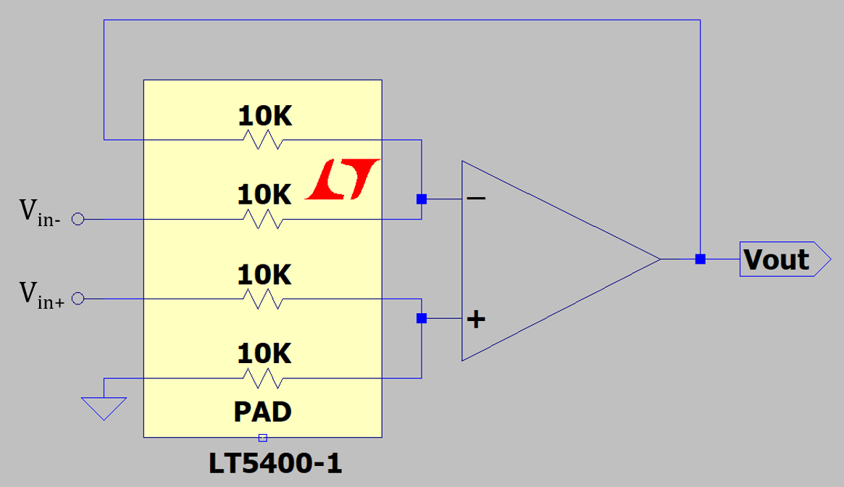
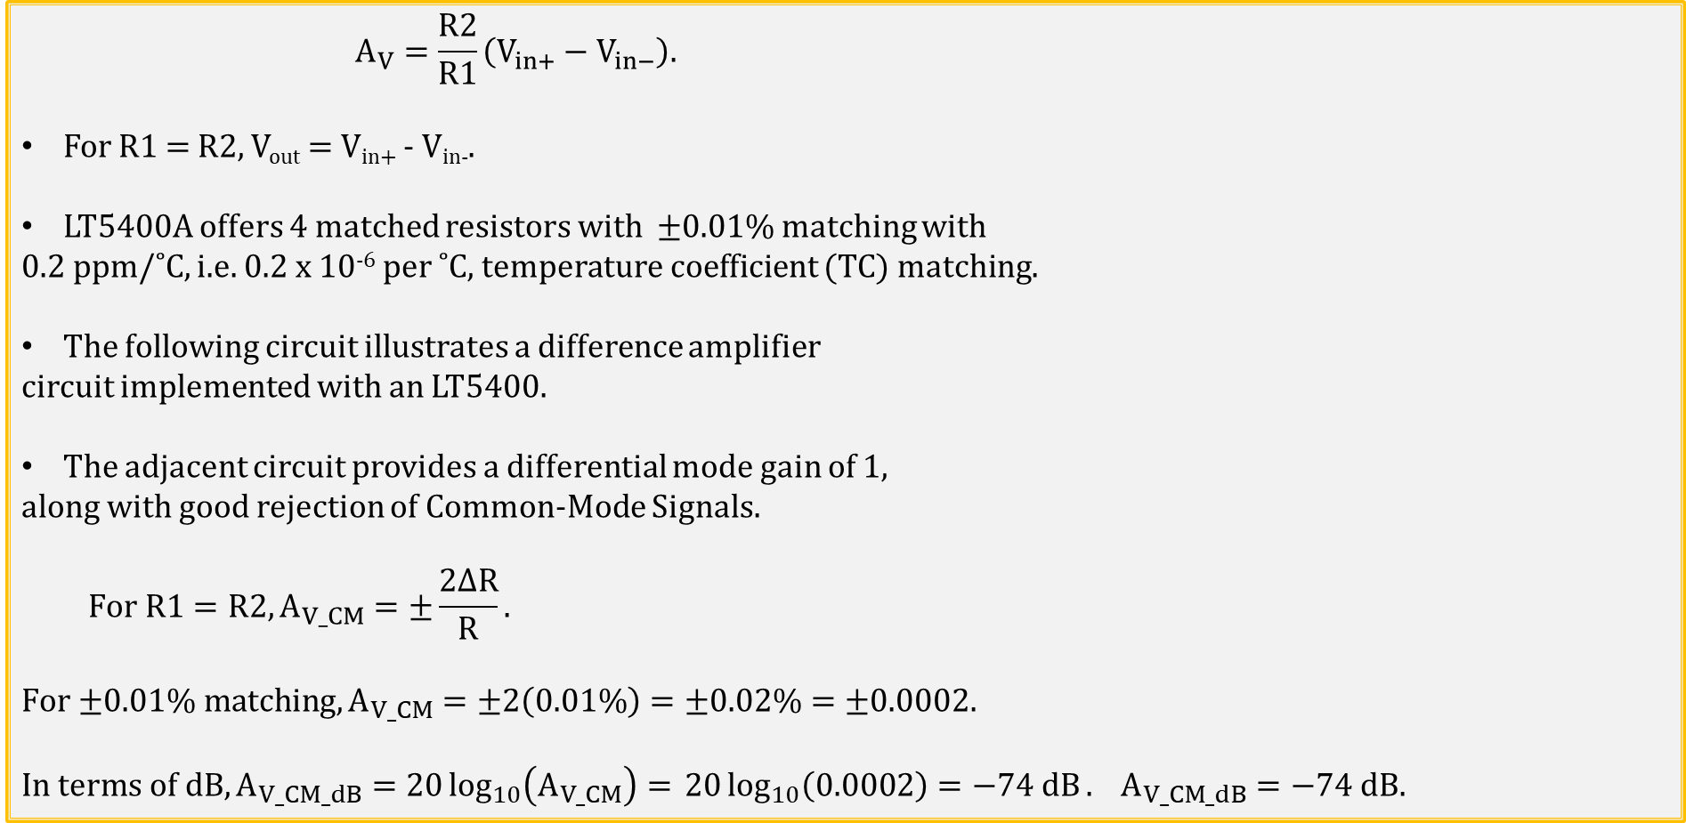
Practical Differential Amplifier Circuit (Continued)
$$A_{V}=\frac{R2}{R1}\left(V_{in+}−V_{in−}\right).$$
For R1 = R2, V_{out} = V_{in+} - V_{in-}.
LT5400A offers 4 matched resistors with ±0.01% matching with
0.2 ppm/˚C, i.e. 0.2 x 10⁻⁶ per ˚C, temperature coefficient (TC) matching.
The following circuit illustrates a difference amplifier
circuit implemented with an LT5400.
The adjacent circuit provides a differential mode gain of 1,
along with good rejection of Common-Mode Signals.
$$For R1=R2, A_{V_CM}=±\frac{2∆R}{R}.$$
$$For\text{ ±0.01\% }\text{matching}, A_{V_CM}=±2\left(0.01\%\right)=±0.02\%=±0.0002.$$
$$In terms of dB, A_{V_CM_dB}=20\log_{10}\left(A_{V_CM}\right)= 20\log_{10}\left(0.0002\right)=−74 dB. A_{V_CM_dB}=−74 dB.$$

Slide 27
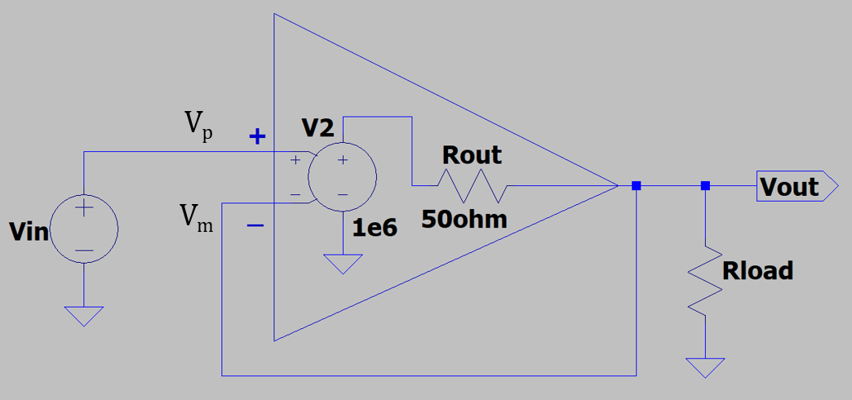
Practical Voltage Follower
For an ideal op-amp V_{p} = V_{m}, and for V_{in} = 1.00 V, V_{out} = 1.00 V for the
voltage follower configuration.
Yet if V_{p} = V_{m}, and V_{p} – V_{m} = 0 V, then doesn’t V_{out} = A_{V}(V_{p} – V_{m} ) = 0?
Mathematically, V_{out} = (∞)(0 V) is indeterminate for an ideal op-amp.
Practical op-amps have open-loop gains < ∞, resulting in the voltage follower output approximately equal to V_{in}.
For example, given an open loop gain A_{V} = 1 x 10⁶, and V_{p} = V_{in} = 1.00 V, V_{out} = V_{m} ≈ 1.00 V.
In the above circuit, since V_{out} = A_{V}(V_{p} – V_{m} ) = (1 x 10⁶)(V_{p} – V_{m} ) ≈ 1.00 V, with (1 x 10⁶)(1 µV) = 1.00 V.
Therefore, V_{p} - V_{m} ≈ 1 µV, meaning V_{m} = V_{out} = 1.00 V - 1 µV = 0.999999 V instead of 1.00 V.
So for the above voltage follower with an open loop gain A_{V} = 1 x 10⁶, and V_{p} = V_{in} = 1.00 V, V_{out} = V_{m} = 1.00 V - 1 µV = 0.999999 V, which is close enough to 1.00 V for practical applications.
A large open-loop gain and negative feedback associated with op-amps result in V_{p} ≈ V_{m} , which for hand calculations is well approximated as V_{p} = V_{m}.

Slide 28
ECEN 350 – Topics
Semiconductor Physics
IC Op-Amps
Rectifiers
Zeners
Diodes
BJTs
MOSFETs
CMOS
LEDs
Transistor Biasing
Small-Signal Analysis
Amplifier Gain Stages
Frequency Response

Slide 29
The End

Slide 30
Extra

Slide 31
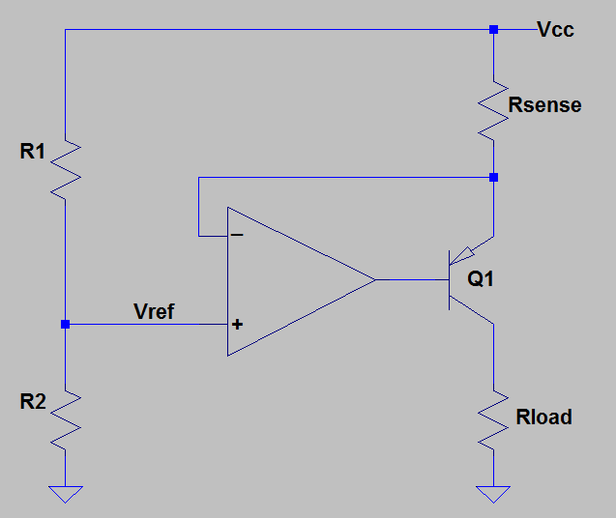
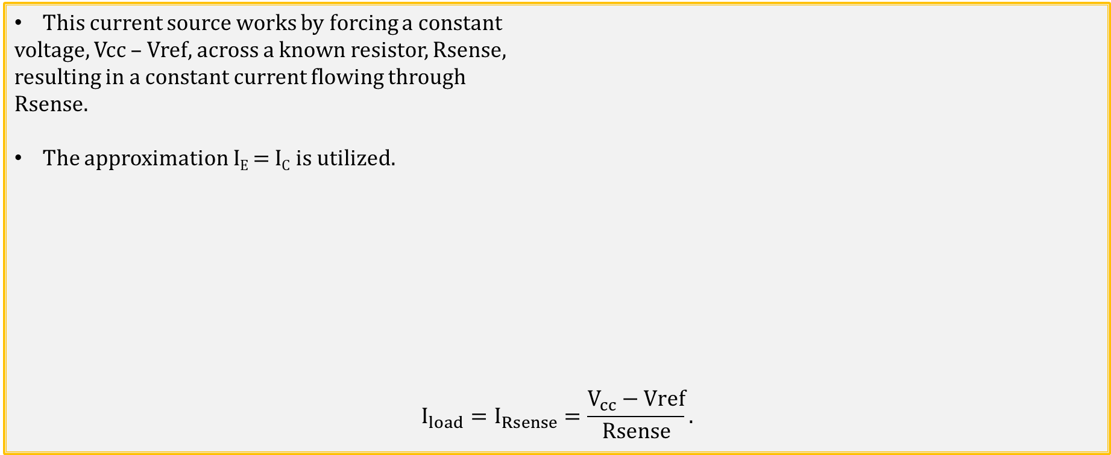
Current Source Circuit
This current source works by forcing a constant
voltage, Vcc – Vref, across a known resistor, Rsense,
resulting in a constant current flowing through
Rsense.
The approximation I_{E} = I_{C} is utilized.
$$I_{load}=I_{Rsense}=\frac{V_{cc}−Vref}{Rsense}.$$

Slide 32
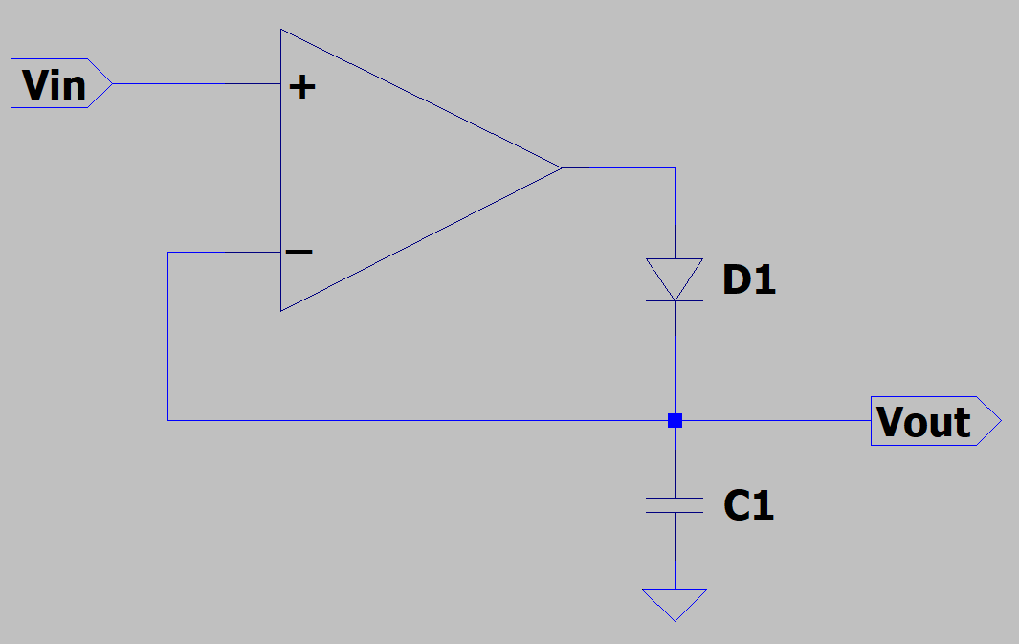
Peak Detector Circuit
Diode D1 results in maximum or peak voltage remaining on capacitor C1.
V_{out} = V_{in_max}.

Slide 33
Operational Amplifiers – Op-Amps
Op-amp – Active circuit element designed to perform the mathematical operations of addition, subtraction, multiplication, division, differentiation and integration.
Name “Operational” comes from analog computer days in which op-amps and other components were used to implement mathematical operations.
The output of an op-amp behaves as a voltage source controlled by the voltage difference between the V_{p} and V_{m} inputs, and R_{o} fairly small, ideally zero.
Op-amp outputs behave like a voltage-controlled voltage-sources.
Op-amp output is governed by the voltage difference between the + and - inputs. Since V_{d} = 0 for common-mode input signals they are rejected.

Slide 34
Operational Amplifiers – Op-Amps
Op-amp – Active circuit element designed to perform the mathematical operations of addition, subtraction, multiplication, division, differentiation and integration.
Name “Operational” comes from analog computer days in which op-amps and other components were used to implement mathematical operations.
The output of an op-amp behaves as a voltage source controlled by the voltage difference between the V_{p} and V_{m} inputs, and R_{o} fairly small, ideally zero.
Op-amp outputs behave like a voltage-controlled voltage-sources.
Op-amp output is governed by the voltage difference between the + and - inputs. Since V_{d} = 0 for common-mode input signals they are rejected.

Slide 35
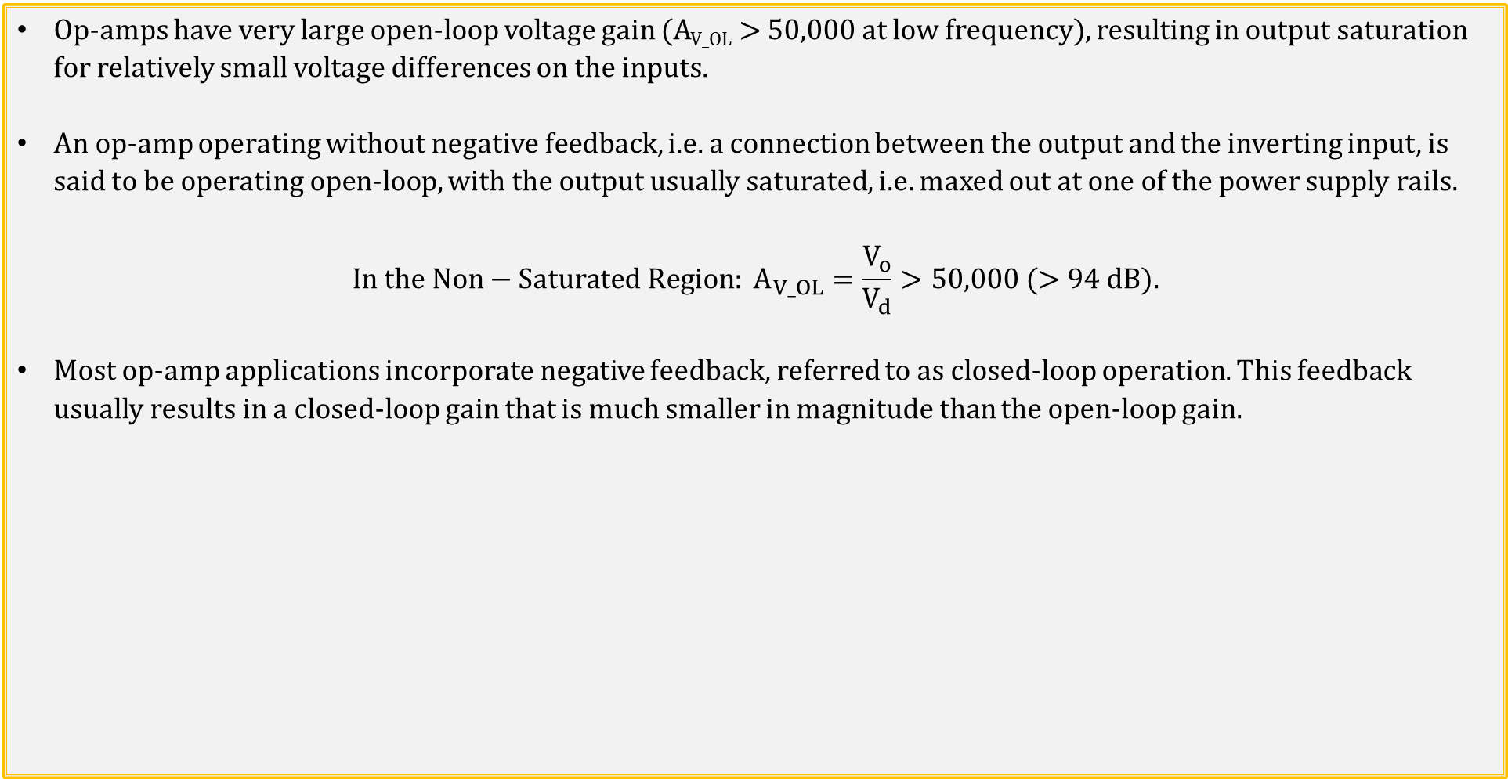
Open-Loop Op-Amp Transfer Function
Op-amps have very large open-loop voltage gain (A_{V_OL} > 50,000 at low frequency), resulting in output saturation for relatively small voltage differences on the inputs.
An op-amp operating without negative feedback, i.e. a connection between the output and the inverting input, is said to be operating open-loop, with the output usually saturated, i.e. maxed out at one of the power supply rails.
$$In the Non−Saturated Region: A_{V_OL}=\frac{V_{o}}{V_{d}}>50,000 (>94 dB).$$
Most op-amp applications incorporate negative feedback, referred to as closed-loop operation. This feedback usually results in a closed-loop gain that is much smaller in magnitude than the open-loop gain.

Slide 36
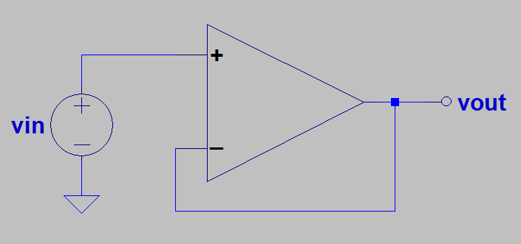
Feedback Control
Feedback control: Inverted Pendelum
Feedback control is used to keep the bottom (-) end of the pendulum in vertical alignment with the top (+) end, with the controller constantly minimizing any difference. As a result, the bottom (-) end follows the vertical position of the top (+) end of the inverted pendulum. The horizontal corrective response of the controller has to be larger than any misalignment to keep the pendelum inverted, making large horizontal gain and quick response time desirable. The larger the vertical mis-alignment, the larger the corrective response to minimize the misallignment.
Feedback control: Voltage Follower
Feedback control is used to keep the minus (-) input of the op-amp equal to the plus (+) input, with the op-amp output constantly minimizing any difference. As a result, the minus (-) input follows the voltage of the plus (+) input of the op-amp when the output is connected to the minus (-) input, referred to as negative feedback. The corrective response of the op-amp has to be larger than any |v_{p} - v_{m}|, for the output to follow the input, making large open-loop voltage gain and quick response time desirable. The larger the magnitude of v_{p} - v_{m},, i.e., |v_{p} - v_{m}|, the larger the corrective response to minimize |v_{p} - v_{m}|.
v_{p}
v_{m}
Poll Questions.

Slide 37
Feedback Control
Hot
Feedback control:
Use negative feedback (negative because output is connected to minus input) to minimize the difference between the desired output voltage and the actual output voltage.
Feedback control:
Use negative (balancing) feedback to minimize the difference between the desired water temperature and the actual water temperature.
Cold

Slide 38

Operational Amplifiers → Op-Amps
What is needed for a modern Integrated Circuit (IC) op-amp?
Differential input stage.
Single-ended output.
Very large open-loop voltage gain.
Very small input current into the + and – inputs.
Differential input stage is fundamental to op-amp construction in order to attenuate amplify voltage differences between the + and – inputs while attenuating voltages common to both inputs.
Additional gain stages used to provide overall open-loop voltage gain.
For integrated Circuits (ICs), need to build op-amps out of mostly transistors and diodes, with resistors as needed along with small value (< 100 pf) capacitors as needed.
Hence coupling and bypass capacitors are not an option, rather dc coupling is utilized.

Slide 39

Op-Amps (Continued)
Because of the large open-loop voltage gain, if the voltage on
the non-inverting input is slightly greater than the voltage on
the inverting input, then the output will increase in voltage
towards V_{CC}.
Likewise, if the voltage on the inverting input is slightly
greater than the voltage on the non-inverting input, then
the output will decrease in voltage towards V_{EE}.
Op-amp output is governed by the voltage difference between the + and - inputs. Since V_{d} = 0 for common-mode input signals they are rejected.

Slide 40
Ideal Op-Amps
An ideal op-amp utilizes the following three assumptions, commonly used for hand calculations:
1. Infinite open-loop gain, i.e. A_{V} = ∞.
2. Infinite input resistance, meaning current into the two input terminals equals 0.00 µA.
3. Zero output resistance, which is the assumption made for an ideal voltage source.
Parameter | Typical Range | Ideal Values
Open-Loop Voltage Gain, A_{V} | 10⁵ to 10⁸ | ∞
Input Resistance, R_{i} | 10⁵ to 10¹³ Ω | ∞ Ω
Output Resistance, R_{o} | 10 to 100 Ω | 0 Ω
Supply Voltage Range (V_{CC} – V_{EE}) | 5 V to 30 V | Any Value

Slide 41
Op-Amps (Continued)
Why can we assume the current into the minus and plus inputs is zero?
Because a differential amplifier input stage is used,
along with high β transistors for low input currents.
Input bias currents into differential pair input transistors usually in the range of pA to nA,
which is often negligible.

Slide 42

Voltage Follower with Buffer Transistor
What is V_{out} and why?
V_{p} = V_{i}. V_{o} = V_{m}.
Also V_{m} = V_{p}. Therefore V_{o} = V_{i}.
Why does V_{m} = V_{p}?
Because of large open-loop voltage gain and negative feedback.
The resulting voltage gain with feedback, i.e. closed-loop gain = 1 because of negative feedback, whereas open-loop gain >> 1.
Why would you add Q1?
Because Q1 can provide much more current to R_{load} than the op-amp output.

Slide 43

Voltage Follower as a Buffer
DMM Measurement Details Lab Circuit.
10 MΩ output (Thevenin) resistance equals
10 MΩ input resistance of a standard DMM.
Result is a voltage divider with a standard DMM
measuring approximately 5.0 V instead of 10 V. (-50%).
Need a buffer stage, i.e. very high input impedance, followed by relatively low output impedance to fix this measurement problem.
Voltage follower configuration does the job well.
For the buffer output, the 10 MΩ input
resistance of a standard DMM is no problem
because of the relatively low
output-impedance of the voltage-follower
op-amp.
Ideally hand-held DMM reports a measured voltage equal to V_{th} with buffer circuit.

Slide 44


Voltage Follower Application
The voltage divider relationship applies when I_{R1} = I_{R2}, meaning
that it only applies for series circuits. The adjacent voltage follower
amplifier buffers the output of the voltage divider, sensing the
voltage V_{a} without requiring any input current, so I_{R1} = I_{R2}. Hence, the
voltage divider relationship applies, resulting in an output voltage V_{out}
that equals V_{a} from the voltage divider. For the adjacent circuit assuming
an ideal op-amp, calculate the output voltage V_{out}.
$For voltage follower:V_{out}=V_{a}=\frac{\left(7.5 V\right)R2}{R1+R2}=\frac{\text{(7.5 }\text{V}\text{)(1.5 }\text{k}\text{Ω)}}{\text{4.5 }\text{k}\text{Ω}}=2.50 V.V_{out}=2.50 V$.
The voltage follower op-amp buffers the voltage divider output V_{a}, providing an output voltage equal to V_{a} even when the op-amp output drives a modest load resistor.
Ideal op-amps have zero output resistance, i.e. are ideal voltage sources.
Practical op-amps have 10 to 100 Ω output resistance and can provide 10 to 20 mA output current.

Slide 45

Buffered Op-Amp Using BJT Emitter Follower
For the adjacent circuit, what is V_{out}?
Because op-amp output adjusts the base-to-emitter voltage of the BJT until the BJT collector current I_{c} multiplied by Rload = V_{in}, i.e. the output voltage is regulated over a wide range of load resistance values, termed a Voltage Regulator.
Voltage Regulators may need to provide more than 1 A of output current.
BJT source-follower in above circuit increases output current well beyond the 10 to 20 mA possible from the op-amp output.

Slide 46

Buffered Op-Amp Using MOSFET Source Follower
Ideal op-amps have zero output resistance, i.e. are ideal
voltage sources.
Practical op-amps have 10 to 100 Ω output resistance and
can only provide 10 to 20 mA output current.
Voltage Regulators may need to provide more than 1 A
of output current.
MOSFET source-follower in above circuit increases output
current well beyond the 10 to 20 mA possible from the op-amp
output.
For the above circuit, V_{out} = V_{ref}. Why?
Because op-amp output adjusts the gate-to-source voltage of the MOSFET until the MOSFET drain current I_{D} multiplied by R_{load} = V_{ref}, i.e. Voltage Regulator.

Slide 47
Voltage Regulator with Current Limit
When Q1 is in cutoff, V_{out} = Vref.
Yet when Q1 turns on, I_{out_max} = I_{lim}.
How do we calculate I_{lim}?
I_{lim} ≈ (0.66 V)/(4.2 Ω) = 157 mA. Why?
When Q1 turns on it limits the gate-to-source
voltage of M1, even when the op-amp is tries to increase
the gate-to-source voltage. Hence, the gate-to-source voltage of M1 equals the voltage necessary for I_{D} = I_{lim} in current limit.
In current limit V_{out}, no longer equals V_{ref}, and instead equals (I_{lim})Rload.
This effective and simple current limit is much more convenient than a 1-time blowable fuse for circuit protection.
For the above circuit, what is the maximum power dissipation of M1 assuming V_{out} = V_{ref}?
P_{M1} = [V_{DD} - V_{out} - I_{Limit}(4.2 Ω)](I_{limit}). The maximum output current is often limited by power dissipation of M1.

Slide 48

Classic 741 Op-Amp
Emitter Follower
V_{BE} Current Limit.
Emitter Follower
A component-level diagram of the common 741 op-amp. Dotted lines outline: current mirrors (red); differential amplifier (blue); output gain stage (magenta); voltage level shifter (green); emitter-follower output stage (cyan).

Slide 49


AD8221 IC Instrumentation Amplifier Example 2
$$Differential Mode Gain: A_{V}=\frac{49.4 kΩ}{R_{G}}+1.$$
Platinum Resistance Thermometers (PRTs) provide
accurate temperature measurements based on the
positive temperature coefficient of resistance of platinum
metal.
A 100 Ω PRT has a nominal resistance of 100 Ω @ 0˚C.
One type of 100 Ω PRTs offers a TCR of 0.3851 Ω/˚C.
This 100 Ω PRT resistance versus temperature can be modeled mathematically as follows for a 1st approximation:
R(T) = (100 Ω)[1 + 0.003851(T)], for T in ˚C.
The Wheatstone bridge provides a differential signal that is nominally 0.0 mV, when the PRT resistance equals 100 Ω.
Notice that resistors R3 and R4 of the Wheatstone bridge, do not equal resistor R1 and R_{PRT} at 0˚C. Resistor values larger than 100 Ω are chosen for R3 and R4 in order to reduce the required current.
The IA output voltage is to be measured by means of a microcontroller Analog-to-Digital Converter (ADC), and then PRT temperature determined by the appropriate output voltage to temperature conversion equation.

